Slide 1
Oracle Cloud Infrastructure (OCI)
Networking Services
Anas Abdallah
Cloud Networking Specialist
Luis Catalan Hernandez
Cloud Networking Specialist
Apr 25, 2025

Slide 2

Agenda
WAN Connectivity (On-prem/OCI/Multicloud)
Dynamic Routing Gateway (DRG)
VPN
Fast Connect
Oracle Interconnect with Azure and GCP
Q&A
Troubleshoot Network Issues
Network Visualizer
Network Path Analyzer (NPA)
Inter-Region Latency Dashboard
VCN Flow Logs
Q&A
Implementation Approach
1
2
3
4
OCI Networking Core Components
Overview on VCN
VCN Security
Routing & Gateways
Load Balancing
Web Application Firewall (WAF)
OCI Network Firewall
Domain Name System (DNS)
IP Management
Q&A
Customer Onboarding
Hub & Spoke Architecture
Redundant Connectivity
Multi-Region Communication
DRCC
Q&A

Slide 3



OCI Network Core Components

Slide 4
Overview on VCN

Slide 5
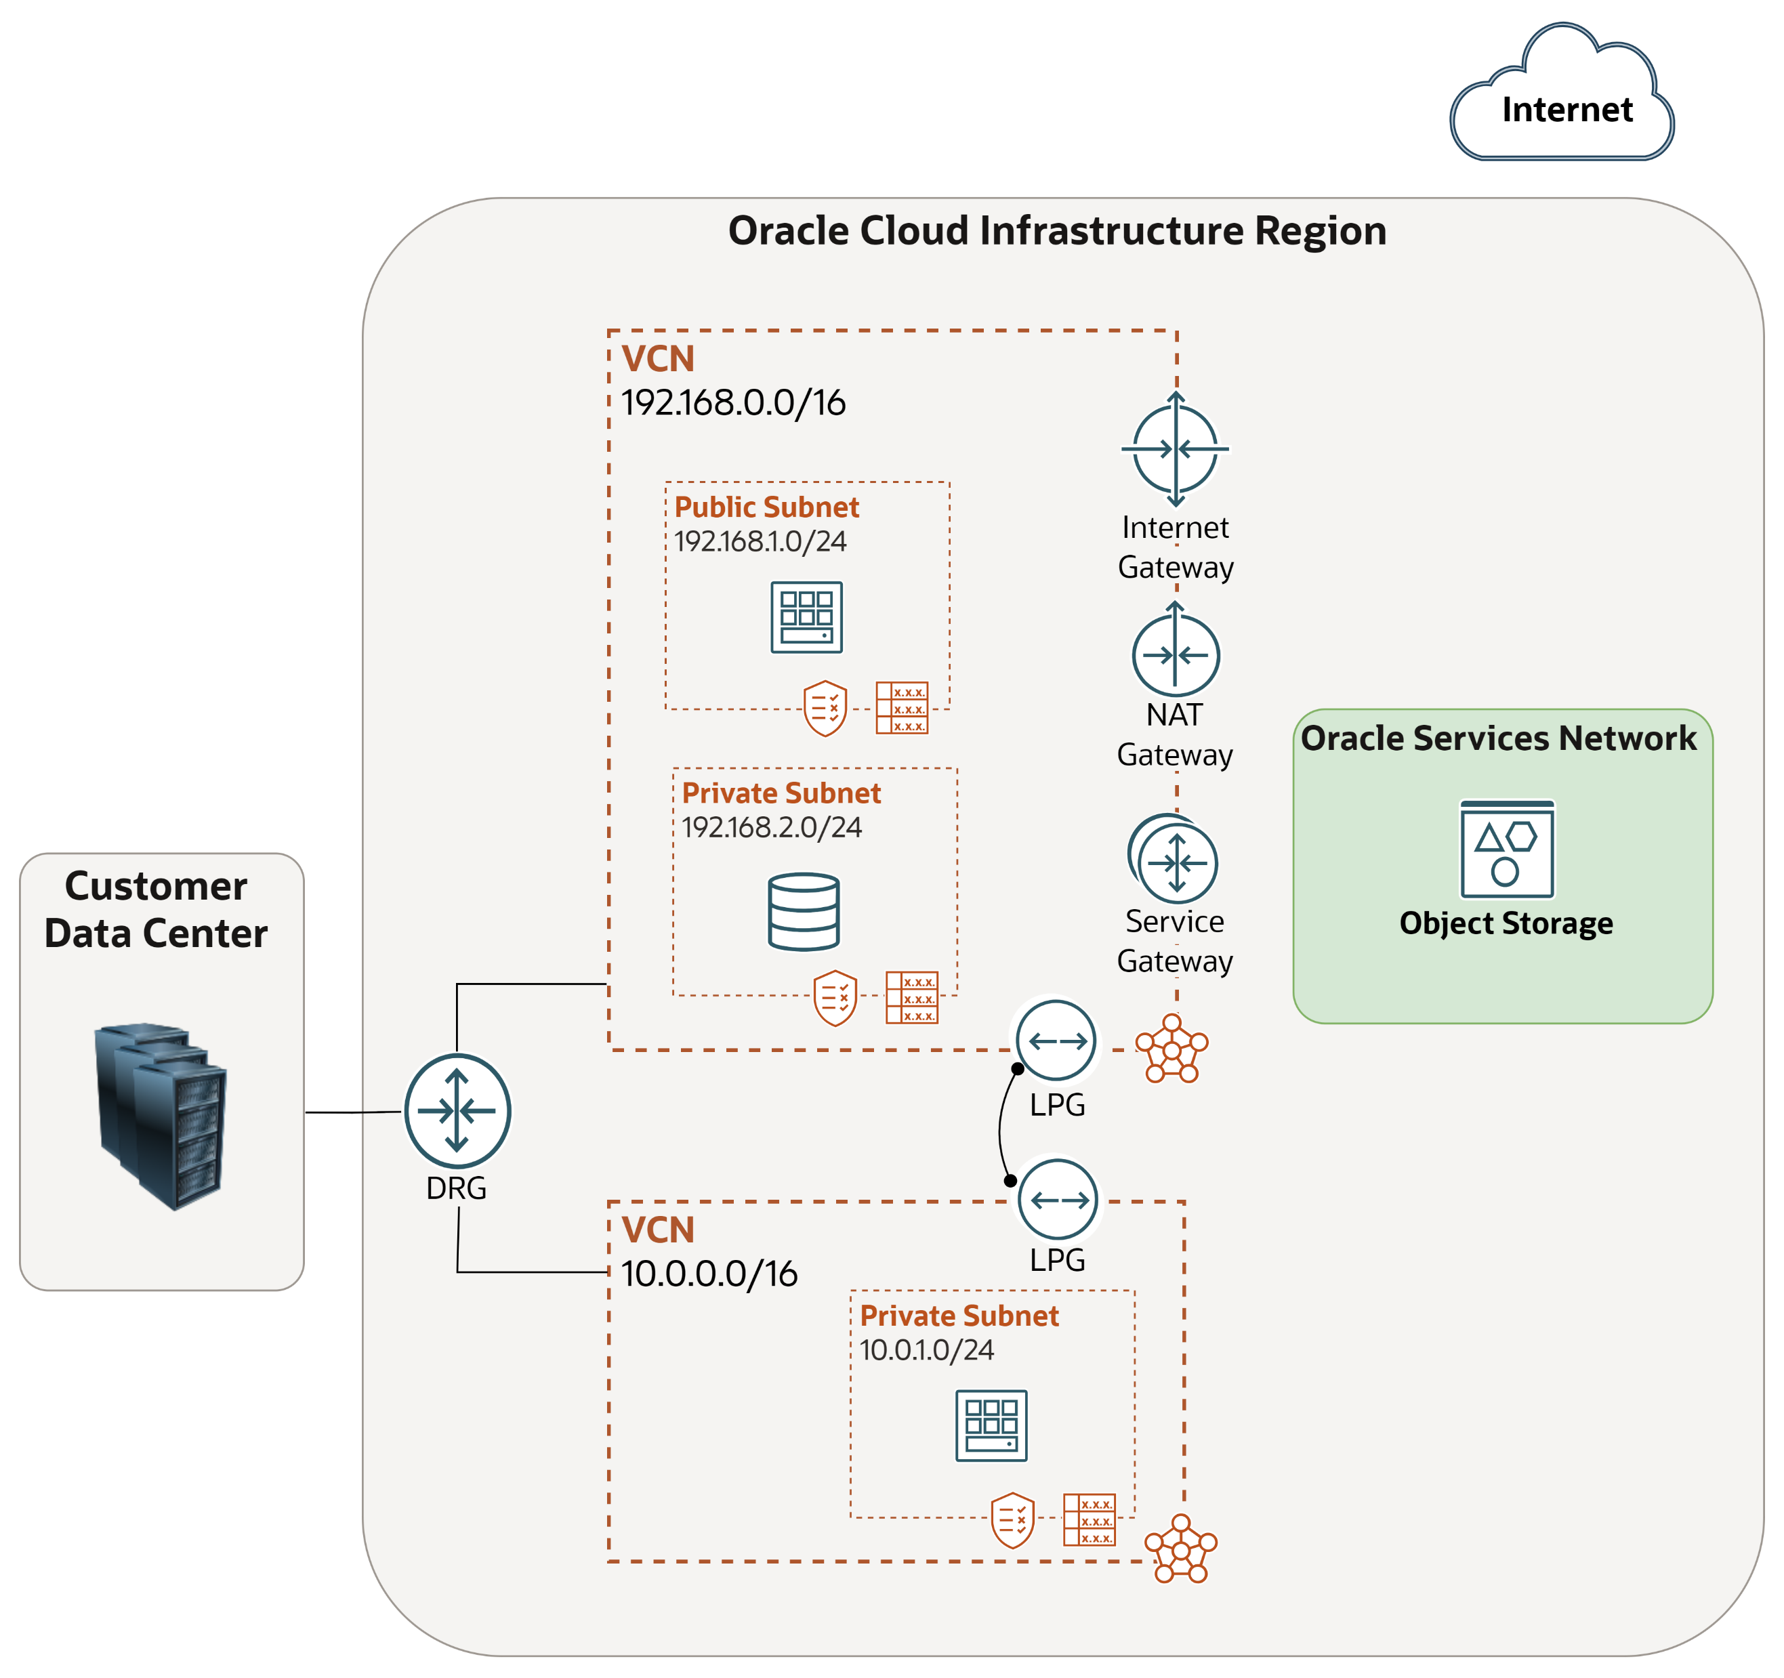
What is a Virtual Cloud Network (VCN) ?
Each VCN is subdivided into Subnets
To secure your resources within the VCN, use security rules:
e.g.
Allow inbound SSH traffic (port 22)
Allow inbound & outbound web traffic (port 80)
…
To route traffic out of the VCN, use Route Tables
What are the Gateways types available in OCI ?

Slide 6
Virtual Cloud Network (VCN)
A private network that you set up in the Oracle data centers, with firewall rules and specific types of communication gateways that you can choose to use.
A VCN covers contiguous IPv4 CIDR blocks of your choice.
A VCN resides within a single region.
Notes:
Network Load Balancers are used to route TCP (or Layer 4) traffic.

Slide 7
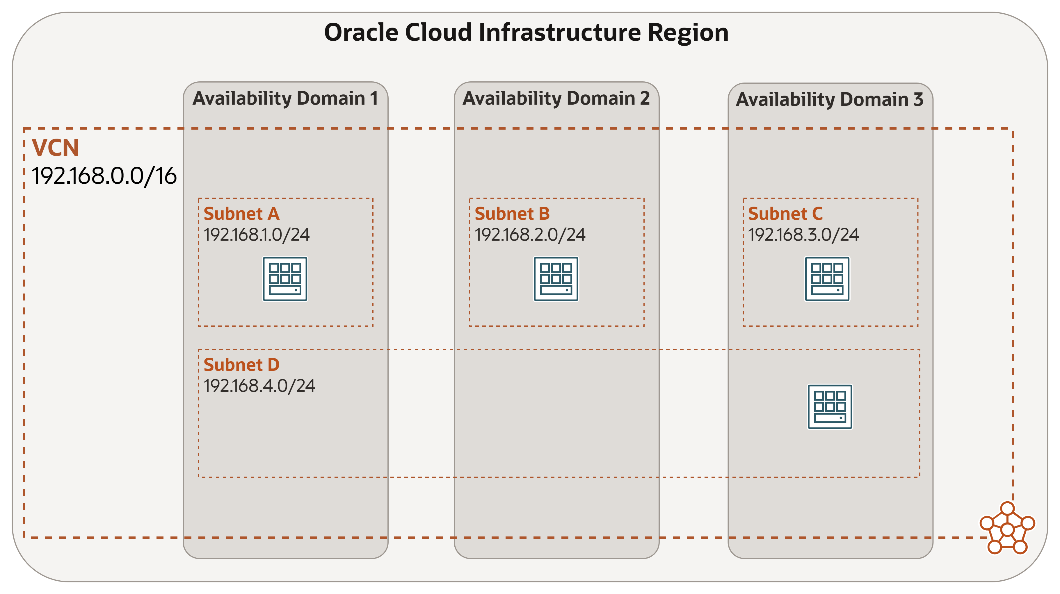
Subnet
Each VCN network is subdivided into subnets.
Each subnet can be AD-specific or Regional (recommended)
AD specific subnet is contained within a single AD in a multi-AD region.
Regional subnet spans all three ADs in a multi-AD region.
Each subnet has a contiguous range of IPs, described in CIDR notation. Subnet IP ranges cannot overlap .
Instances are placed in subnets and draw their internal IP address and network configuration from their subnet.
Subnets can be designated as either
Private (instances contain private IP addresses assigned to VNICs).
Public (contain both private and public IP addresses assigned to VNICs).
VNIC is a component that enables a compute instance to connect to a VCN. The VNIC determines how the instance connects with endpoints inside and outside the VCN.
Notes:
Network Load Balancers are used to route TCP (or Layer 4) traffic.

Slide 8
VCN Security

Slide 9
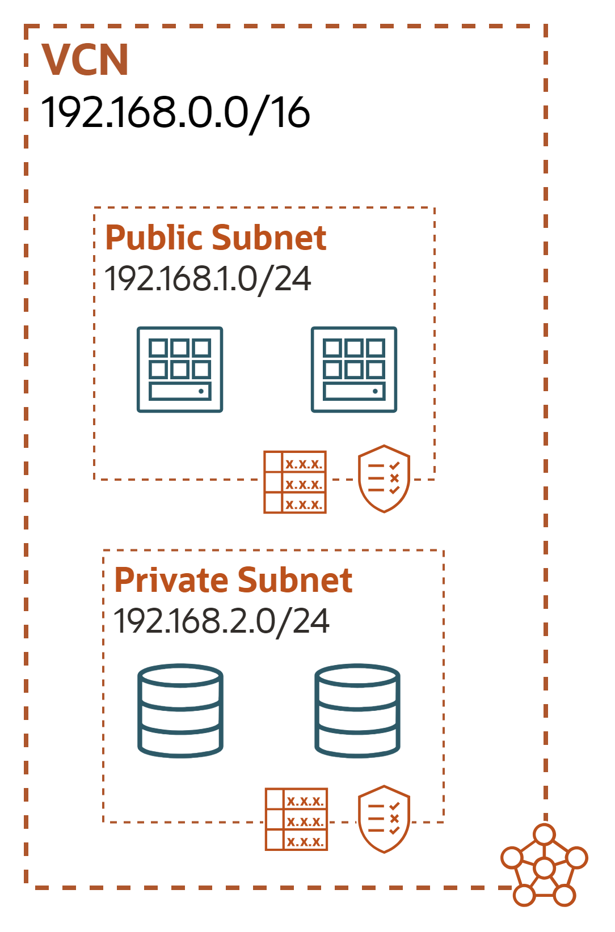
Security Lists
A common set of firewall rules associated with a subnet and applied to all instances launched inside the subnet.
Security list consists of rules that specify the types of traffic allowed in and out of the subnet.
To use a given security list with a particular subnet, you associate the security list with the subnet either during subnet creation or later.
Security list apply to a given instance whether it's talking with another instance in the VCN or a host outside the VCN.
 | Direction | CIDR | Protocol | Source Port | Dest Port
Stateful | Ingress | 0.0.0.0/0 | TCP | All | 80
Stateful | Egress | 192.168.2.0/24 | TCP | All | 1521
 | Direction | CIDR | Protocol | Source Port | Dest Port
Stateful | Ingress | 192.168.1.0/24 | TCP | All | 1521
Notes:
Network Load Balancers are used to route TCP (or Layer 4) traffic.

Slide 10

Network Security Group (NSG)
A network security group (NSG) provides a virtual firewall for a set of cloud resources that all have the same security posture
NSG consists of set of rules that apply only to a set of VNICs of your choice in a single VCN
Currently, compute instances, load balancers and DB instances support NSG
When writing rules for an NSG, you can specify an NSG as the source or destination. Contrast this with SL rules, where you specify a CIDR as the source or destination
Oracle recommends using NSGs instead of SLs because NSGs let you separate the VCN's subnet architecture from your application security requirements
NSG-B
NSG-A
 |  | Direction | CIDR | Protocol | Source Port | Dest Port
NSG-A | Stateful | Ingress | 0.0.0.0/0 | TCP | All | 80
NSG-B | Stateful | Ingress | 0.0.0.0/0 | TCP | All | 22
You can use SLs alone, NSGs alone, or both together.
Notes:
Network Load Balancers are used to route TCP (or Layer 4) traffic.

Slide 11
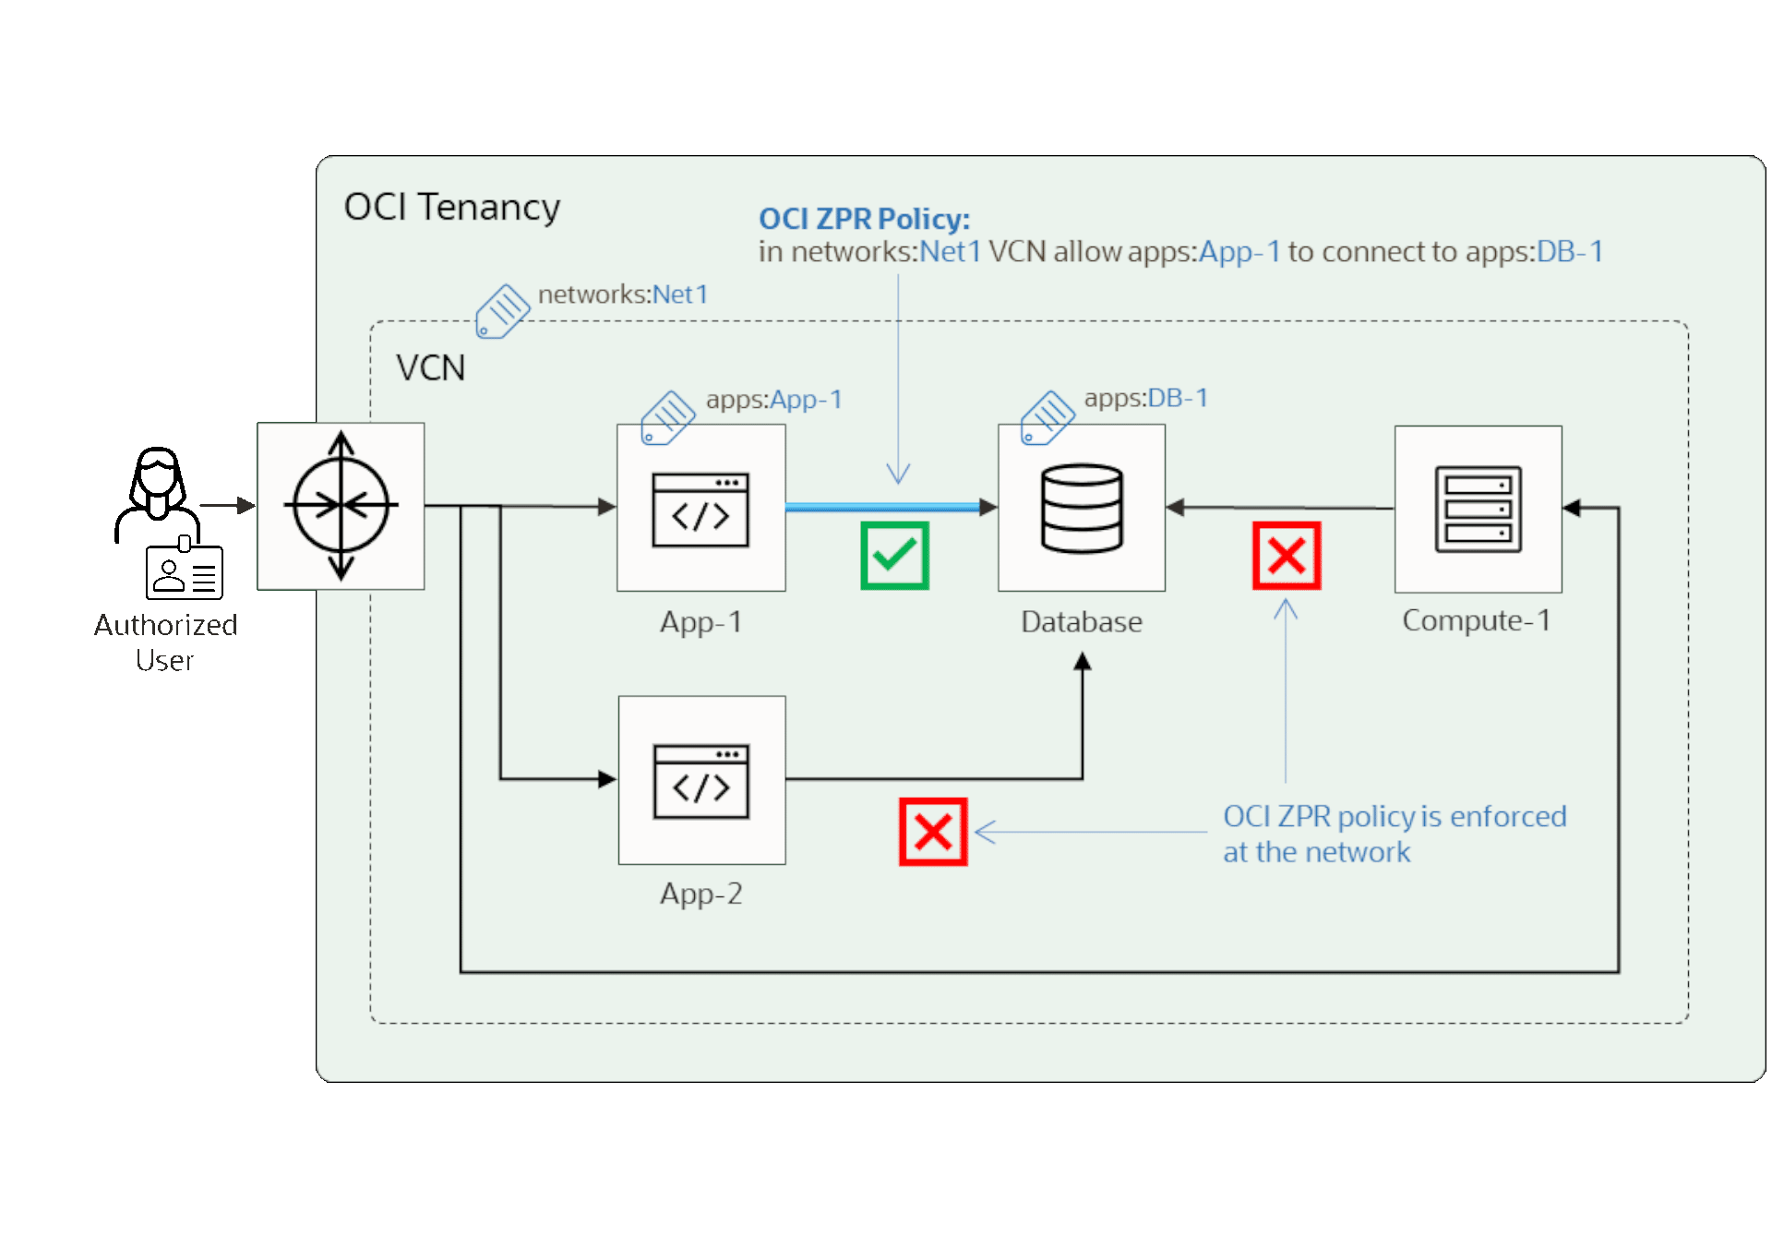
Zero Trust Packet Routing (ZPR)
OCI ZPR provides internal and external threat protection from attackers, controlled with an additional network level security layer. It enables customers to define and enforce an intent-based, data-centric security policy, natively integrated with user and application attributes for resources within OCI and On-premises resources.
Simple, clear policies: Protect your data with one easy-to-understand policy.
Data tagging for seamless protection: Tag your sensitive data, and let the network enforce security policies automatically.
Future-proofed security: Even if your network configuration changes, ZPR ensures data remains protected.
Provable security compliance: Validate policies and prove they are working as intended.
Notes:
Network Load Balancers are used to route TCP (or Layer 4) traffic.

Slide 12
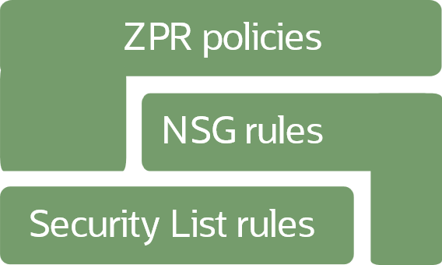
Using ZPR with Other Security Methods
Any VNIC or endpoint must have subnet security list rules that allow it to communicate.
An NSG can add more rules on top of the security list rules for selected resources anywhere in a VCN.
A ZPR policy can be layered on top of both security lists and NSG rules, or the ZPR policy can be in addition to a security list alone.
Notes:
Network Load Balancers are used to route TCP (or Layer 4) traffic.

Slide 13
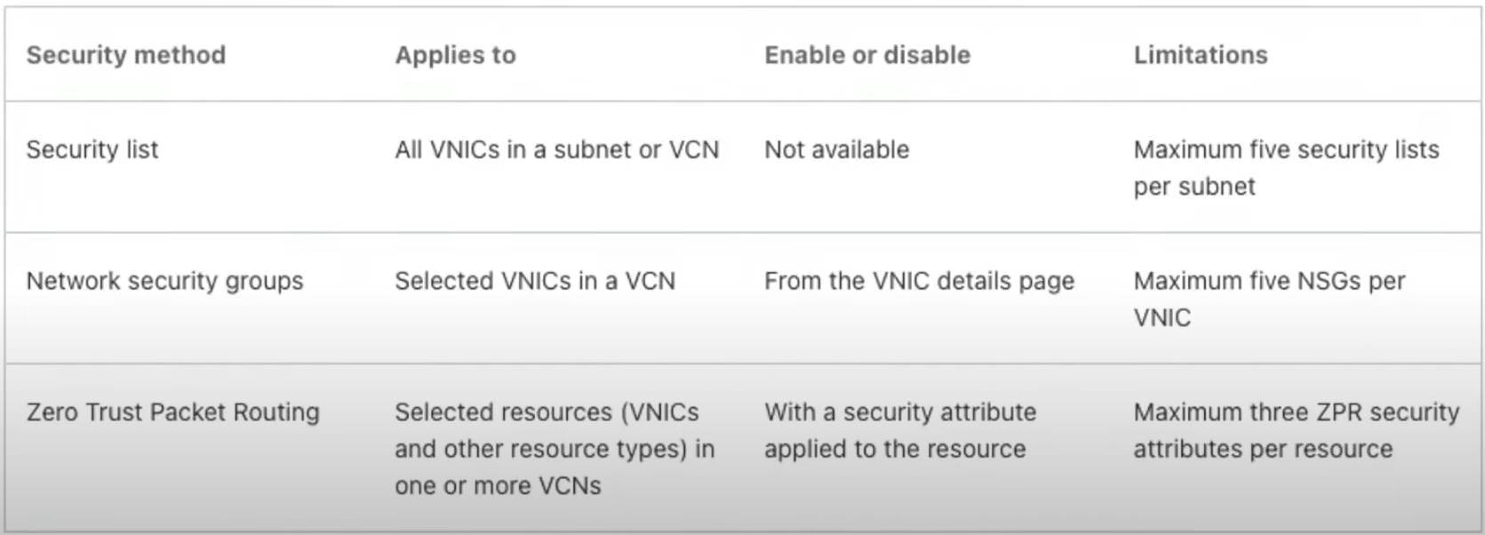
ZPR vs Security Rules
Notes:
Network Load Balancers are used to route TCP (or Layer 4) traffic.

Slide 14
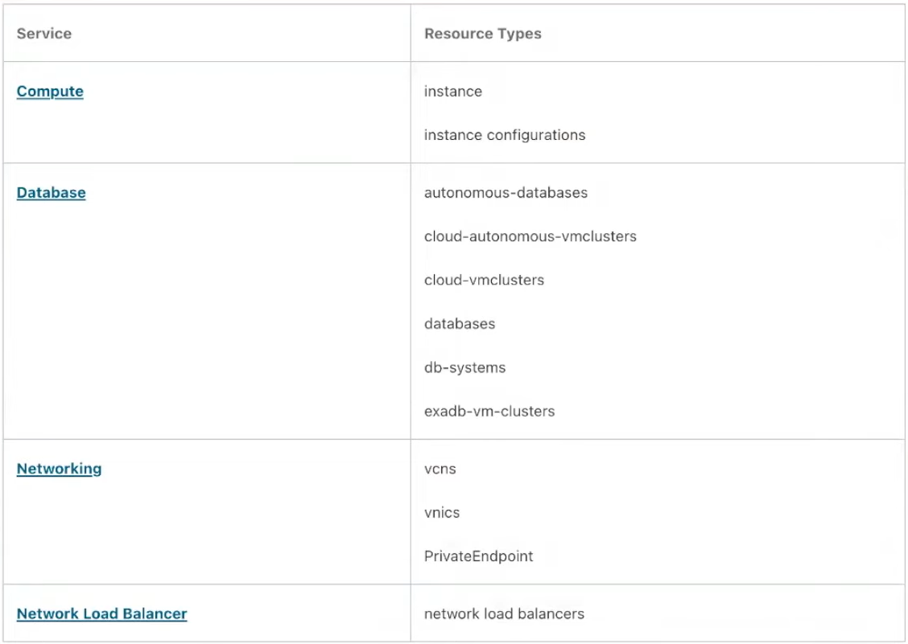
ZPR – Currently Supported OCI Resources
Notes:
Network Load Balancers are used to route TCP (or Layer 4) traffic.

Slide 15
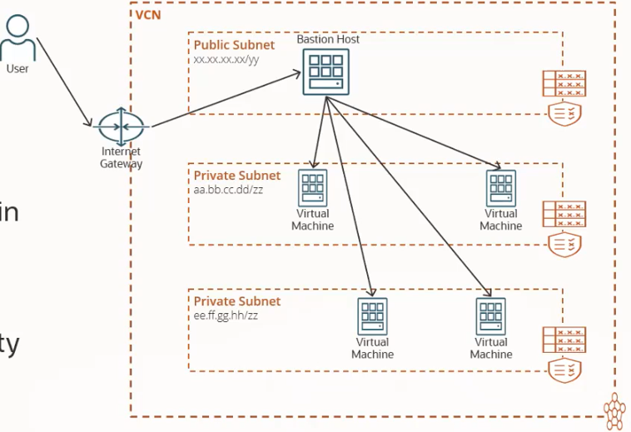

Bastion in the traditional way
A Bastion host is a special-purpose server or an instance that is used to configure to work against the attacks or threats. It is also known as the “Jump Box”.
Bastion host basically provide an entry point into the private networks which are to be connected from external network securing from the attacks.
While using Bastion service you must log in first to your Bastion host and then directed to the private instances.
Notes:
Network Load Balancers are used to route TCP (or Layer 4) traffic.

Slide 16
Bastion in the traditional way
Linux VM acting as a bastion in OCI.
Create a Public Subnet.
Allocate public IP for bastion host.
Compute management by OCI admin.
Hardening of compute OS.
SSH Keys management per user basis.
Storing of SSH private keys for target compute in bastion.
No session limit enforcement.
Cost incurred to run the compute in OCI.
Notes:
Network Load Balancers are used to route TCP (or Layer 4) traffic.

Slide 17
OCI Bastion
OCI provided and managed service.
There is no cost for using OCI Bastion.
No public IP is needed, resulting in no surface attack area or zero-day vulnerabilities.
Eliminate shared credentials, broad access limits, and other bad habits of using jump hosts.
Restricted and time-limited access to target resources that don’t have public endpoints.
Targets can include resources like compute instances, DB systems, and Autonomous Database for Transaction Processing and Mixed Workloads databases.
Notes:
Network Load Balancers are used to route TCP (or Layer 4) traffic.

Slide 18
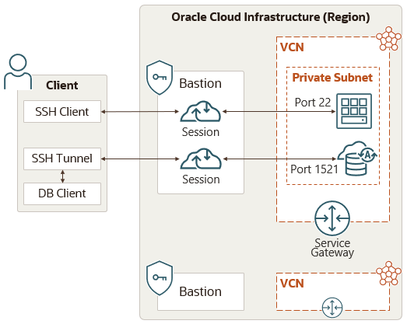
OCI Bastion
A bastion is associated with a single VCN. You cannot create a bastion in one VCN and then use it to access target resources in a different VCN.
Bastion is a regional service. For example, bastion created in Frankfurt cannot be used to access resources in London.
Bastion “Maximum session time-to-live (TTL)” is 3 hours and minimum is 30 minutes. The TTLs is configurable at the session level.
Bastion is restricted with service limits per region per tenancy.
5 bastions per region.
20 active sessions per bastion.
Notes:
Network Load Balancers are used to route TCP (or Layer 4) traffic.

Slide 19
Routing & Gateways

Slide 20
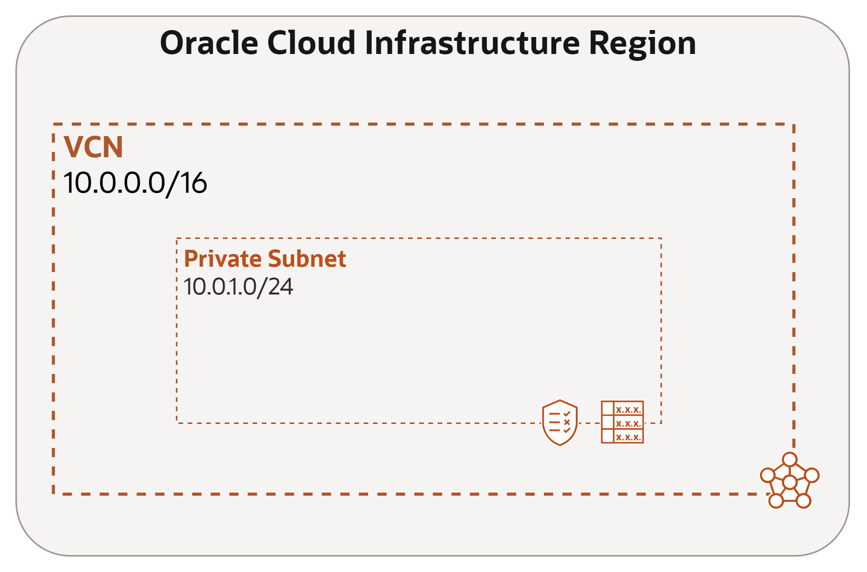
Route Table
Associated with a Subnet.
Used to send traffic out of the VCN.
Consists of a set of route rules; each rule specifies the:
Destination CIDR block.
Route target (the next hop) for the traffic that matches the CIDR.
No route rules are required to enable traffic within the VCN itself
Destination | Route Target
0.0.0.0/0 | NAT Gateway
Object Storage | Service Gateway

Slide 21
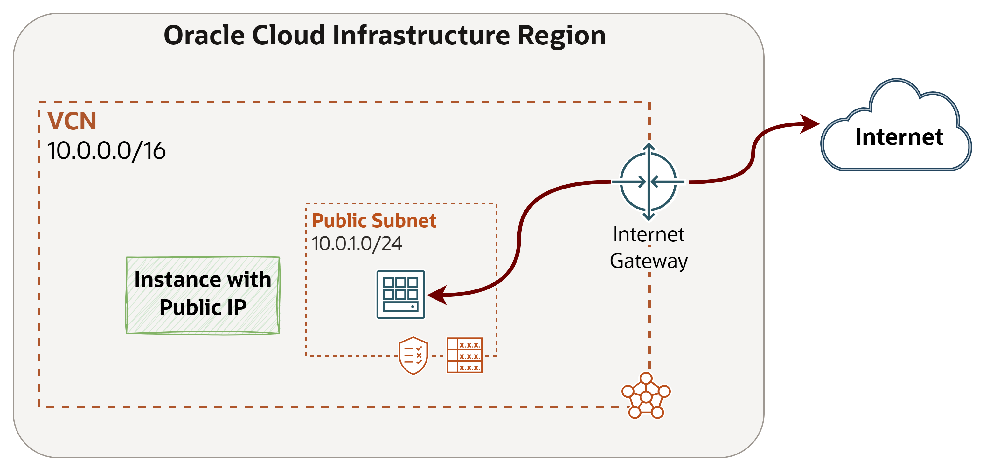
Internet Gateway
Internet Gateway provides a path for network traffic between your VCN and the Internet.
You can have only one Internet Gateway for a VCN.
After creating an Internet Gateway, you must add a route for the gateway in the VCN's Route Table to enable traffic flow.
Destination | Route Target
0.0.0.0/0 | Internet Gateway

Slide 22
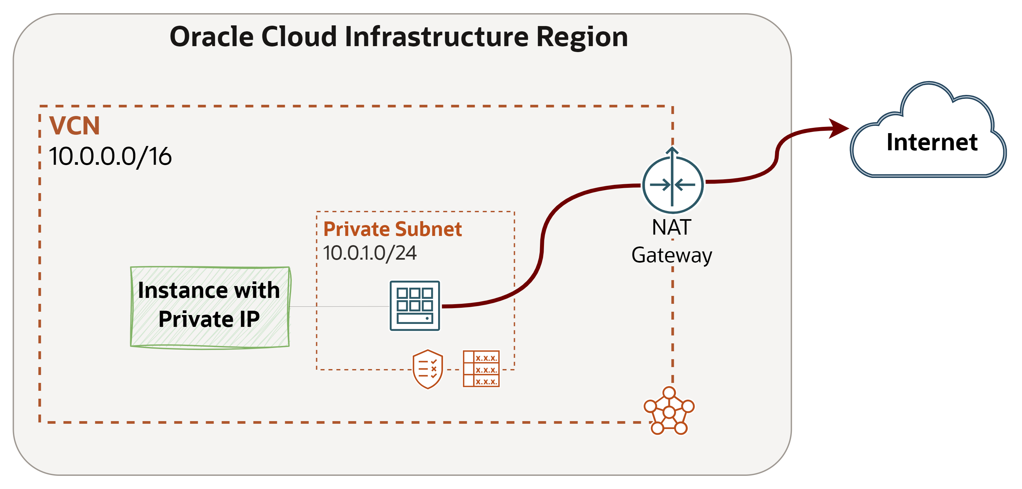
NAT Gateway
NAT Gateway gives a private network access to the Internet without assigning each host a public IP address.
Hosts can initiate outbound connections to the internet and receive responses, but not receive inbound connections initiated from the internet. (Use cases: updates, patches).
You can have more than one NAT gateway on a VCN, though a given subnet can route traffic to only a single NAT gateway.
Destination | Route Target
0.0.0.0/0 | NAT Gateway

Slide 23
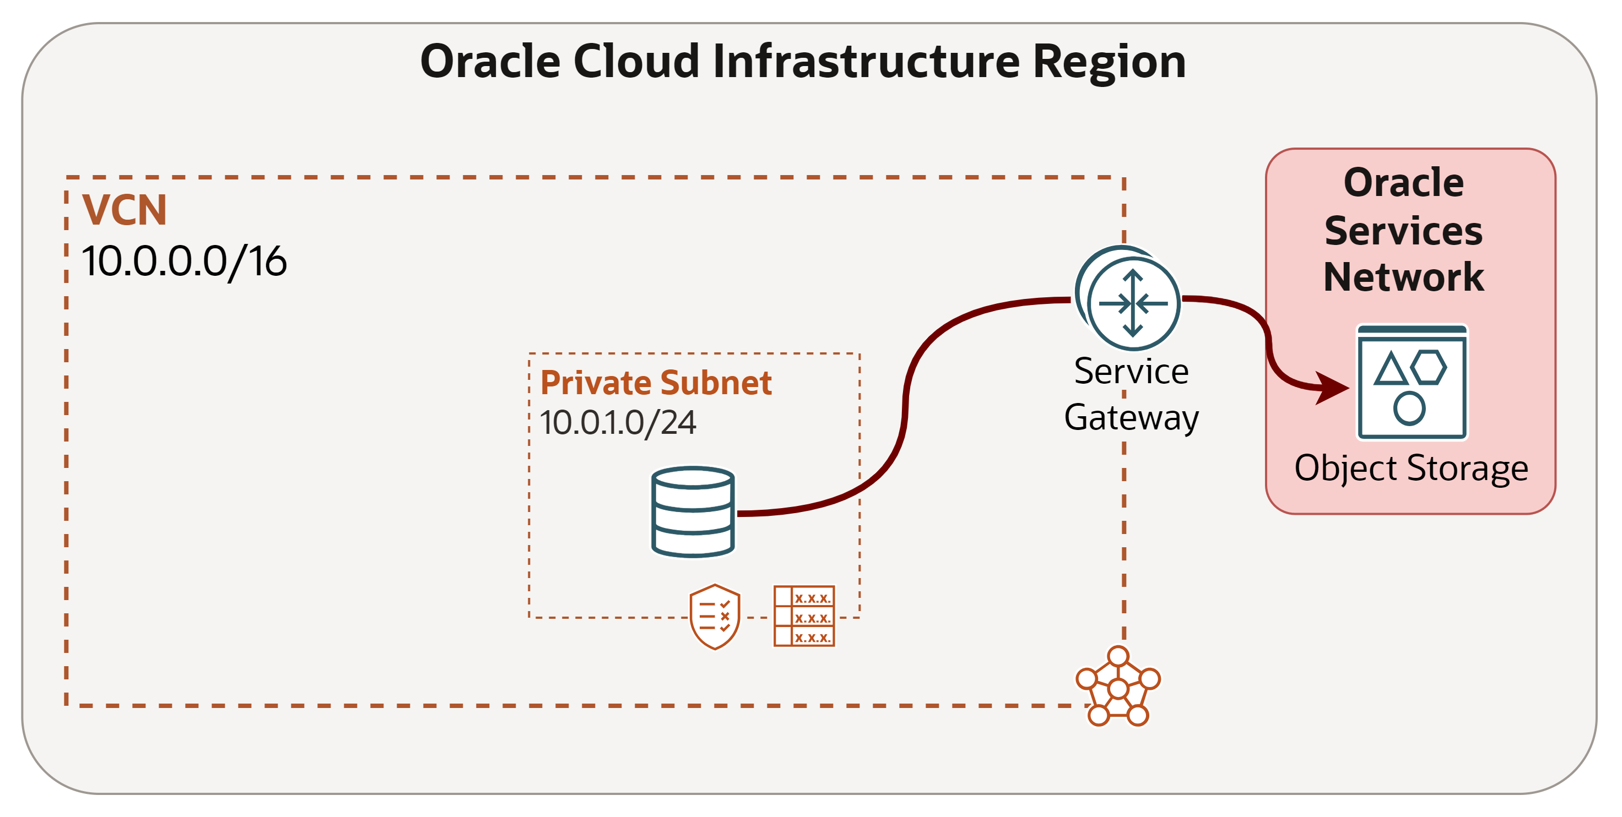
Service Gateway
Service Gateway lets resources in VCN access public OCI services, exposed on the Oracle Services Network (OSN), such as Object Storage, but without using either Internet or NAT gateway.
Any traffic from VCN that is destined for one of the supported OCI public services uses the instance's private IP address for routing, travels over OCI network fabric, and never traverses the internet. (Use case: back up DB Systems in VCN to Object Storage).
Service CIDR labels represent all the public CIDRs for a given Oracle service or a group of Oracle services. E.g.
OCI <region> Object Storage
All <region> Services
Destination | Route Target
Service CIDR Label | Service Gateway

Slide 24
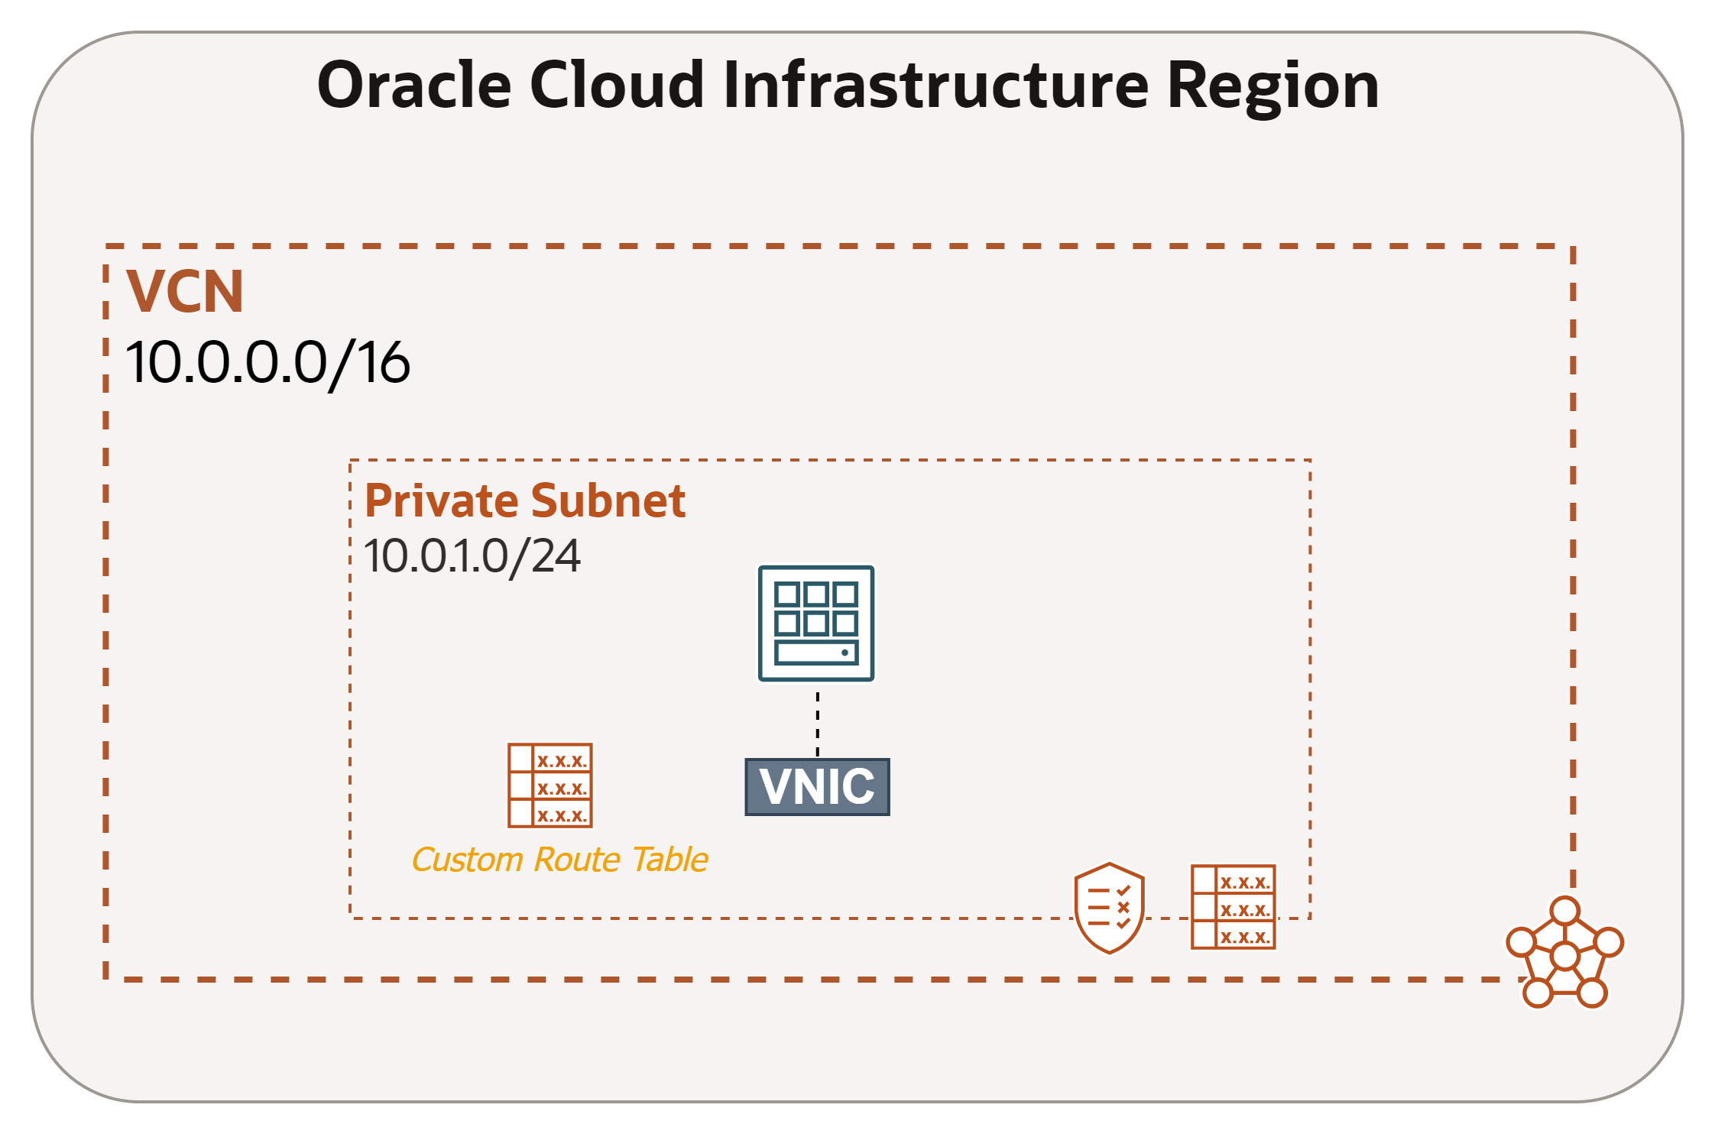
Per-resource Routing
Used to assign a custom VCN route table to one or more VNICs or to a particular IP addresses on a VNIC.
This offers enhanced routing control tailored to each resource in a single subnet, in case they have different requirements, rather than relying solely on the subnet-level route table.
Route Table selection process:
VNIC IP address RT.
VNIC RT.
Subnet RT.

Slide 25
VCN Peering
A method to let VCNs communicate with each other.
Local Peering
Enables communication between VCNs within the same OCI region.
Remote Peering
Enables communication between VCNs in different OCI regions.

Slide 26
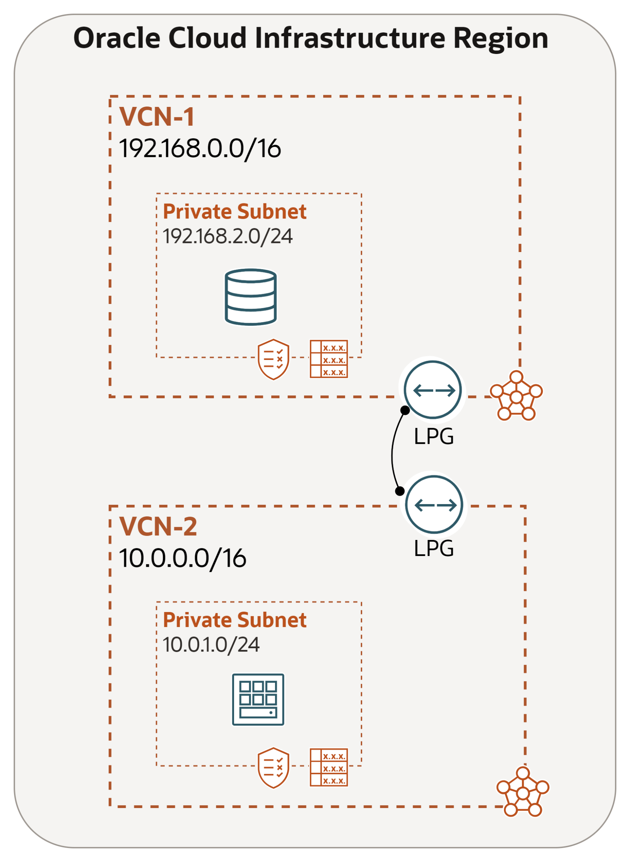
Local VCN Peering – connecting VCNs in the same region
Connecting two VCNs in the same region so that their resources can communicate using private IP addresses without routing the traffic over the internet or through your on-premises network.
VCNs should not have overlapping IP addresses.
Local Peering VCNs can be either in the same or different tenancies (cross-tenancy peering).
Local Peering Gateway (LPG)
Like the Internet Gateway, LPG is a component on the VCN.
LPGs of two VCNs are connected to make a peering relationship.
Enable the data plane to learn about instances in peered VCNs.

Slide 27
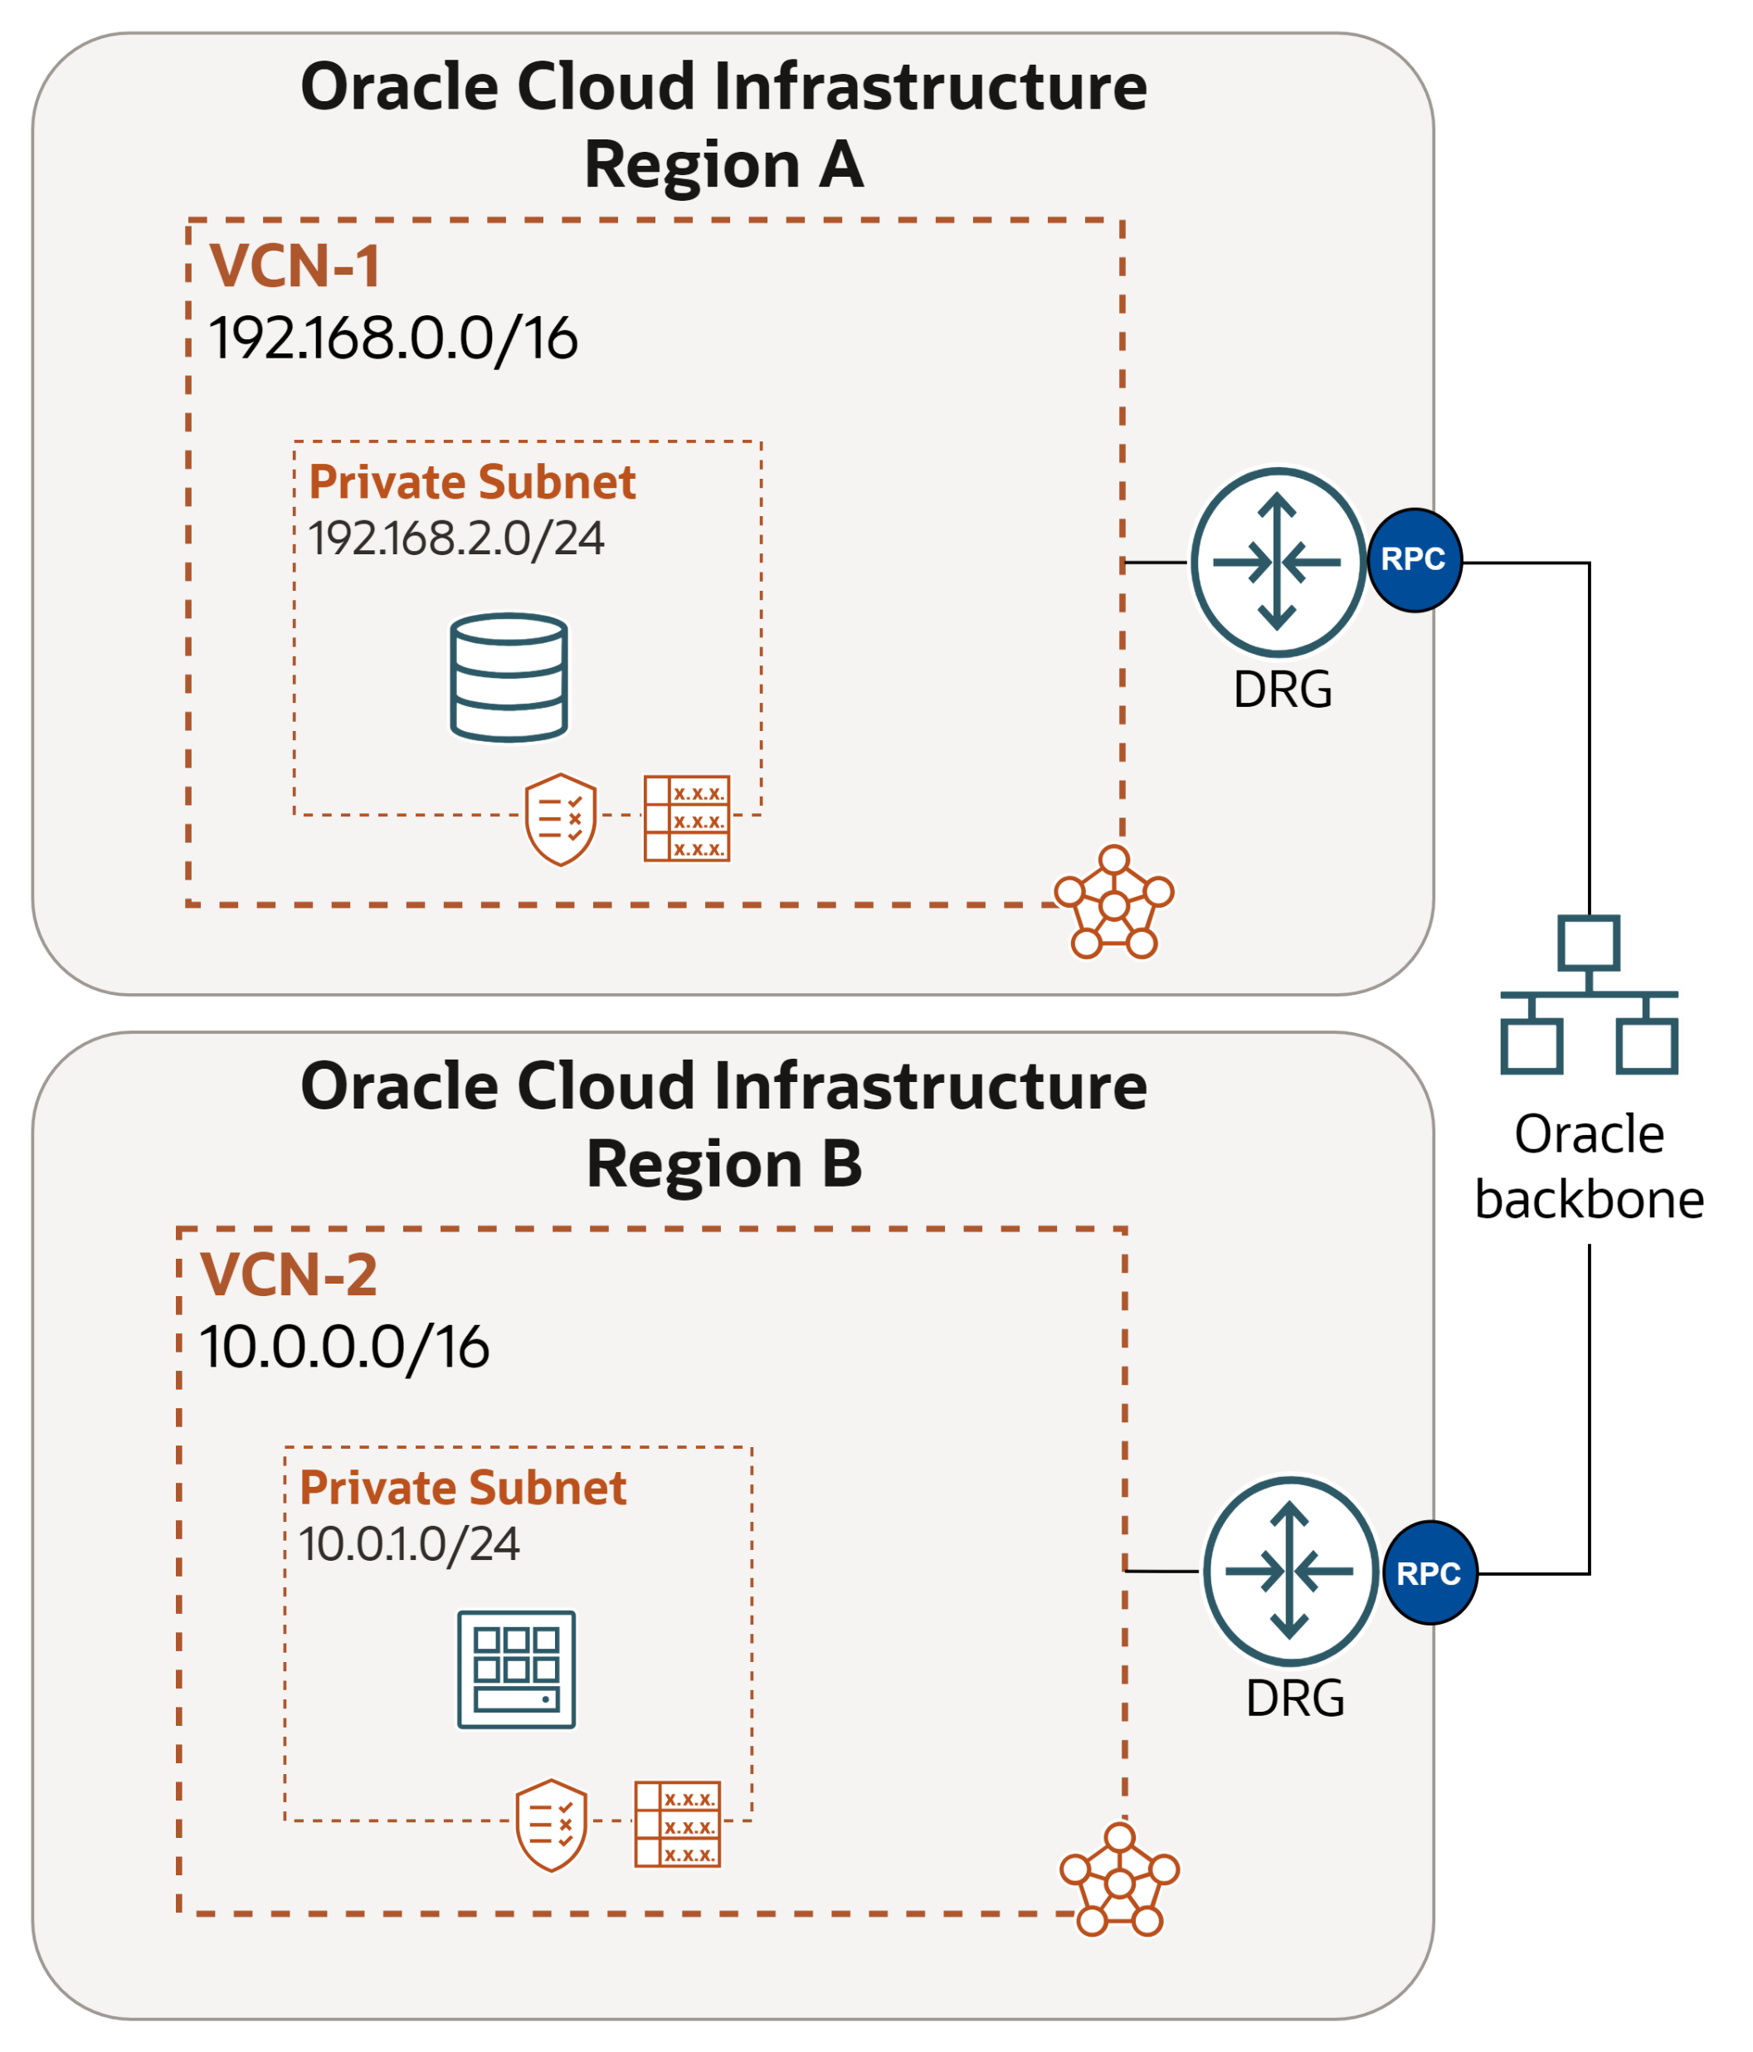
Remote VCN Peering – connecting VCNs in different regions
Traffic flows between regions through the OCI backbone network.
The two VCNs in the peering relationship must not have overlapping CIDRs.
Requires a DRG to set up the Remote Peering connection; vNIC of one VCN instance forwards traffic to its DRG, which forwards traffic to peer DRG in other region over backbone.
Enables features such as data replication across regions.
Remote Peering Connection (RPC)
Like Virtual Circuits, the RPC is a component of DRG.
RPCs of two DRGs from two regions are connected to create a peering relationship.

Slide 28
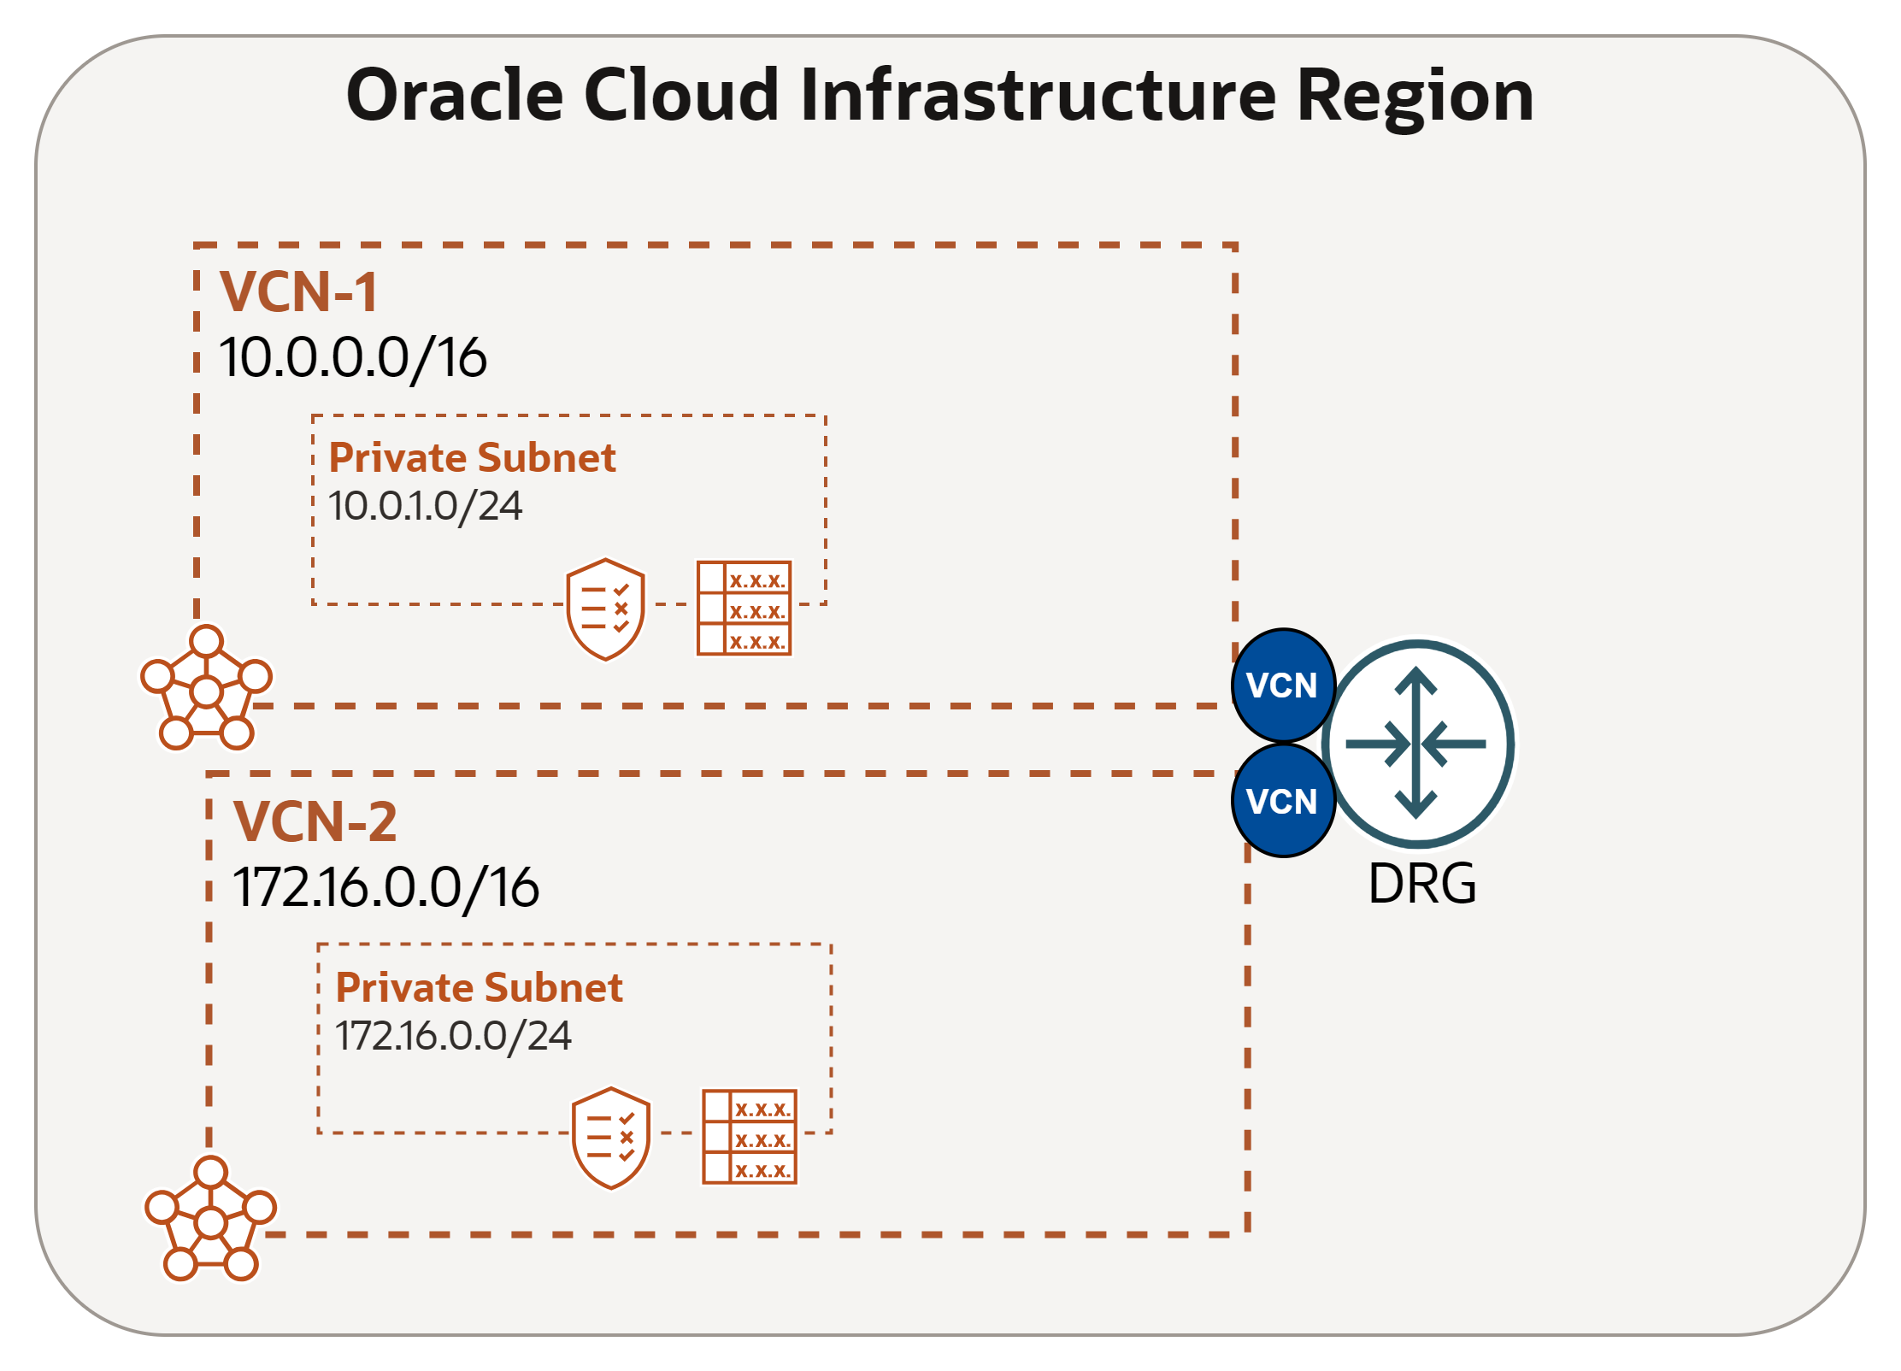
Local VCN Peering with DRG
Oracle recommends using a Dynamic Routing Gateway (DRG) for local VCN peering instead of a Local Peering Gateway (LPG), as DRG offers greater scalability and simplifies the network design.
Using LPG is only recommended in scenarios that require ultra-low latency or high bandwidth. If your use case does not have such requirements, leveraging DRG is preferred due to the flexibility it provides.

Slide 29
Load Balancing

Slide 30
- Resides between end users and backend servers.
Load Balancing
- Load Balancer Improve Resource Utilization, Scalability and ensure High Availability.
A Load Balancer distribute traffic to several backend servers
Web browser
Normal IP traffic between applications
LBs can be:
Layer 4/7, TCP/HTTP layer
Public Public IP and accessible from internet
Layer 4, TCP/UDP, transport layer
Flexible Load Balancer
Network Load Balancer
Private
Private IP and accessible from within VCN
Can terminate SSL traffic on load balancer or pass it through to backend.
Standard Load balancer for public facing web servers.
Directly apply WAF (Web application Firewall) protection onto Flexible Load Balancer.
Flexible shape will use between Min and Max bandwidth depending on traffic, lower cost if less traffic.
Non-proxy, pass through load balancing.
High throughput and ultra low latency.
Optimized for long-running connections (days or months).
A connection always goes to same backend server – good for DB.
Scales up and down automatically based on client traffic, no bandwidth config needed.
No SSL termination.
Notes:
Network Load Balancers are used to route TCP (or Layer 4) traffic.

Slide 31

Flexible Load Balancer Benefits (Layer 7)
Fault tolerance and HA: using health check + LB algorithms, a LB can effectively route around a bad or overloaded backend.
Scalability: LB maximizes throughput, minimizes response time, and avoids overload of any single resource
Naming abstraction: name resolution can be delegated to the LB; backends don’t need public IP addresses
Load Balancer

Slide 32
Load Balancer Components
Listener : Checks for incoming traffic on the load balancer's IP address, listener should configure for type of traffic.
Load Balancing Policy: Distribution algorithm of incoming traffic.
Load Balancer
Health Check: What backends are currently healthy and available to accept requests?
Backend set is a logical entity defined by a load balancing policy, a health check policy, and a list of backend servers.
Backend Server – application server responsible for generating content in reply to the incoming TCP or HTTP traffic

Slide 33
Health Check
Health check is a test to confirm the availability of backend servers.
Health API provides a 5-state health status (ok, pending, incomplete, warning, critical)
Health status is updated every three minutes
Listeners
A Load Balancer IP can have up to 16 listeners (port numbers). Each listener has a backend set that can have 1 to N backend servers
Server 1
Load Balancer IP
Listener
Server 2
Backend set
Listener
Server 3

Slide 34
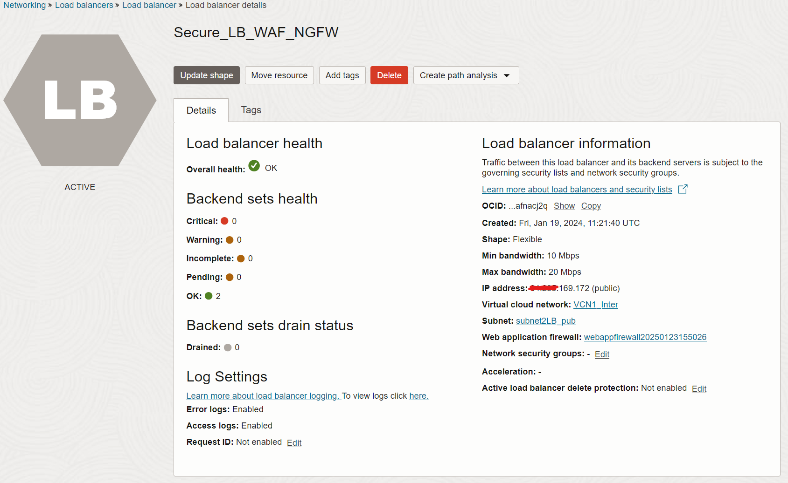

Slide 35
Load Balancing Policies
Round Robin: default policy, distributes incoming traffic sequentially to each server in a backend set. After each server has received a connection, the load balancer repeats the list in the same order.
IP Hash: uses an incoming request's source IP address as a hashing key to route non-sticky traffic to the same backend server.
Least Connection: routes incoming non-sticky request traffic to the backend server with the fewest active connections.
Load balancer policy decisions apply differently to TCP load balancer, cookie-based session persistent HTTP requests (sticky requests), and non-sticky HTTP requests
A TCP load balancer considers policy and weight criteria.
An HTTP load balancer w/ cookie-based session persistence forwards requests using cookie's session info.
For non-sticky HTTP requests, the load balancer applies policy and weight criteria.
Load Balancer

Slide 36
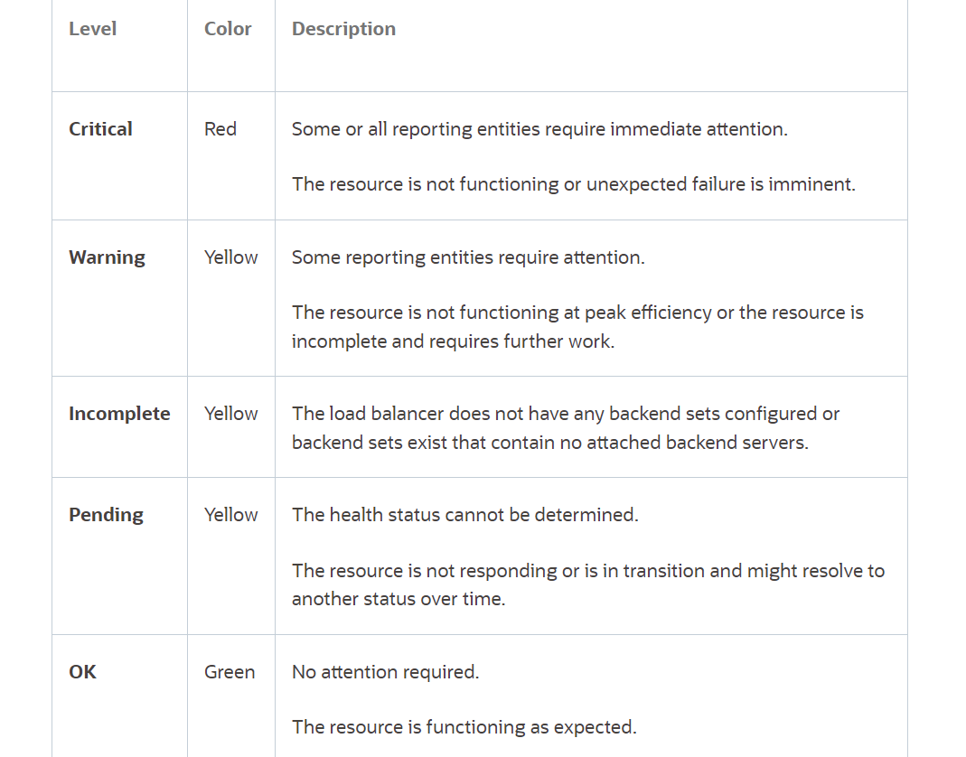
Backend Health Status

Slide 37
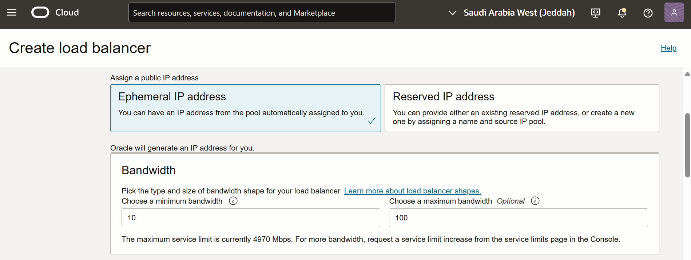
Flexible Load Balancer
Customer just defines the minimum and maximum bandwidth:
Minimum bandwidth provides instant readiness for the load balancer.
Maximum bandwidth allows control of maximum cost.
Customer pays a minimal base cost for the load balancer and then pays a simple single rate.
For the larger of the reserved bandwidth or the maximum bandwidth actually used each minute.

Slide 38
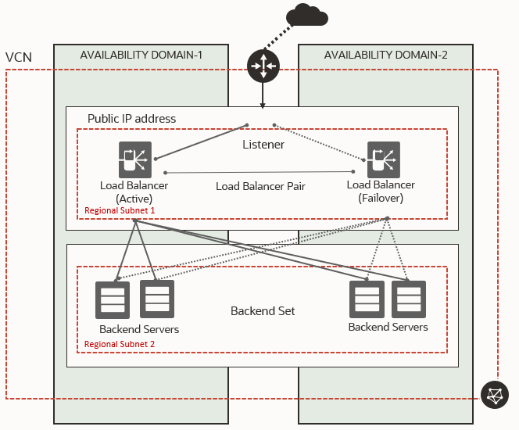
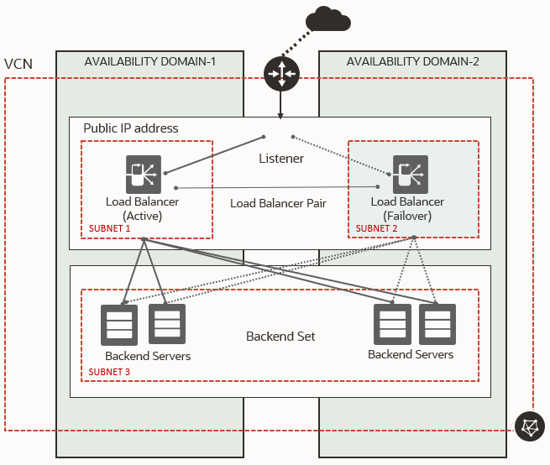
Public Load Balancer (Regional Subnets -Recommended- vs. AD Specific Subnets)

Slide 39
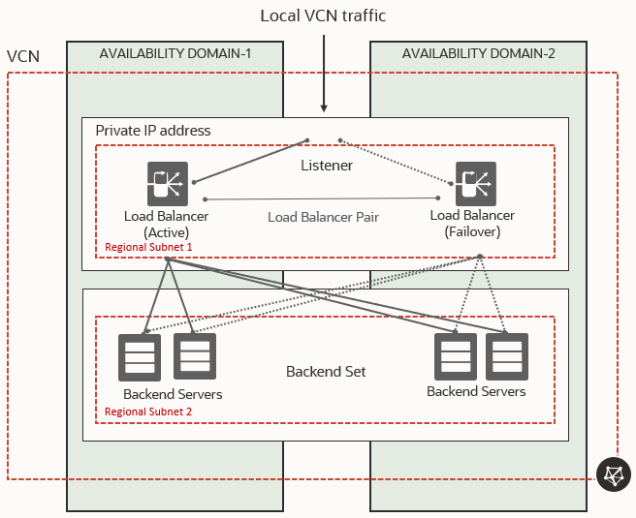
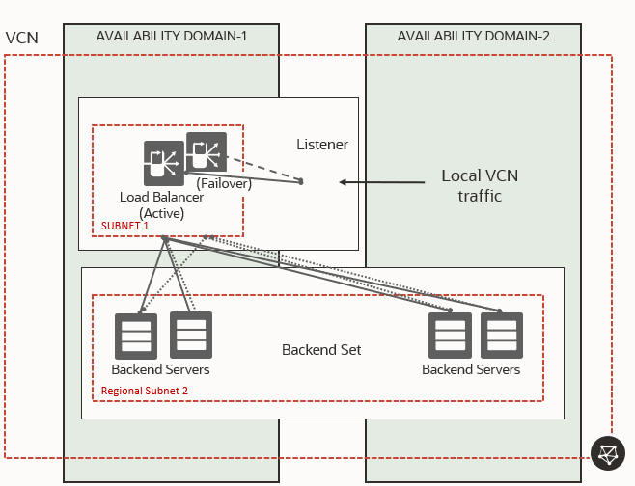
Private Load Balancer (Regional Subnets -Recommended- vs. AD Specific Subnets)

Slide 40
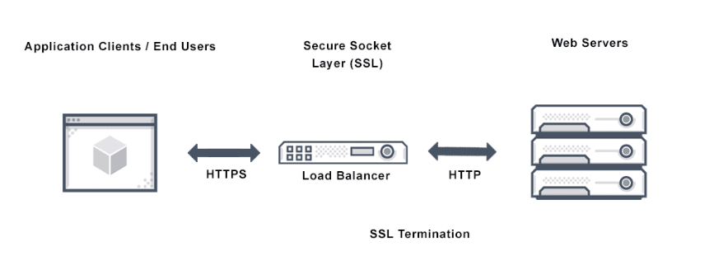
SSL Handling
Terminate SSL at the load balancer. This configuration is frontend SSL. Your load balancer can accept encrypted traffic from a client. No encryption of traffic exists between the load balancer and the backend servers.
Implement SSL between the load balancer and your backend servers. This configuration is backend SSL. Your load balancer does not accept encrypted traffic from client servers. Traffic between the load balancer and the backend servers is encrypted.
Implement point-to-point SSL. Your load balancer can accept SSL encrypted traffic from clients and encrypts traffic to the backend servers.
To use SSL with your load balancer, you must add one or more certificate bundles to your system.
Oracle Cloud Infrastructure accepts x.509 type certificates in PEM format only.

Slide 41
Network Load Balancer (Layer 4)
The Network Load Balancer load balance layer 3 and layer 4 (TCP/UDP/ICMP) workloads
It’s designed to handle volatile traffic patterns and millions of flows, offering high throughput while maintaining ultra-low latency.
Ideal load balancing solution for latency-sensitive workloads includes real-time streaming, VoIP, Internet of Things, HA scenarios and trading platforms.
OCI Network Load Balancer can be public or private.
Symmetric Hashing support for Active/Active configurations.
Full NAT, Source/Destination Header (IP/Port) Preservation (Bump-in-the-wire), Source Header (IP/Port) Preservation.

Slide 42
Network Load Balancer - Policies
5-Tuple Hash: Routes incoming traffic based on 5-Tuple (source IP and port, destination IP and port, protocol) Hash. This is the default network load balancer policy.
3-Tuple Hash: Routs incoming traffic based on 3-Tuple (source IP, destination IP, protocol) Hash.
2-Tuple Hash: Routs incoming traffic based on 2-Tuple (source IP Destination, destination IP) Hash.

Slide 43
OCI Web Application Firewall (WAF)

Slide 44



Increasing cyber attacks
Exploit data
Steal personal data, usernames and passwords to get to more important data
<50%
of companies globally are sufficiently prepared for a cybersecurity attack,
according to a report that surveyed 3,000 business leaders from 80 countries
Source: Eurasia Group, 2019
Hold data ransom
Steal records, personal data, usernames and passwords
and charge the organization to give it back
Steal infrastructure
Take control of an organization's compute, storage and
network resources so not to pay for them
92%
of IT professionals surveyed feel that immaturity in their cloud security
programs is creating a readiness gap
Source: Oracle and KPMG Cloud Threat Report, 2020
Deny service
Prevent web services from working to impact
organization's reputation or bottom line

Slide 45
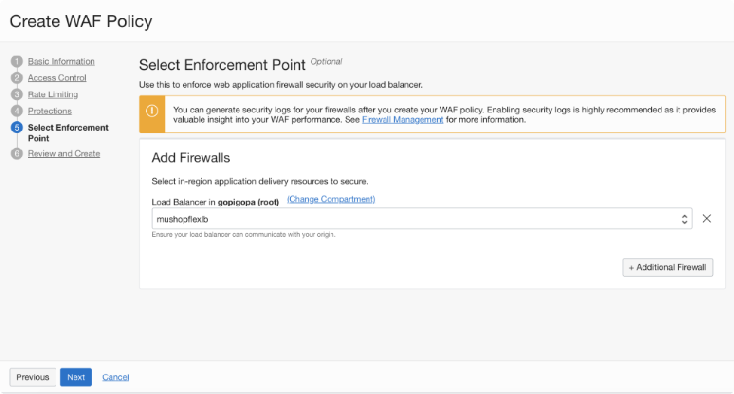
OCI Web Application Firewall (WAF)
Customer benefits
Layered defense and flexibility to enforce security at the edge closest to users as well as in-region closest to the application on flexible load balancers.
WAF policies can be enforced on internet facing web applications, and/or (public/private) flexible load balancer instances.
Protects internet facing and internal applications against both external and insider threats.
Supports access rules, protection rules, rate limiting, and bot management*
OCI WAF protects against threats such as OWASP defined top-10 vulnerabilities. It can be used to limit access to the application based on geography or the signature of incoming requests, block unwanted bots.
OCI WAF protects your application infrastructure and workloads no matter where they reside: in OCI, on-premises, multi-cloud and anywhere in between.
* Bot management is only supported with edge policies.

Slide 46






OCI WAF Features
✕
✕
Access control
Restrict or control access to critical web applications, data and service
Bot management
Identifies whether request are from a human or a machine Controls or blocks non-human suspicious requests
Protection rules
Hides the origin server
Inspects traffic as it tries to access the server or as it leaves the server
Rate limit
Provides protection against L7 DDOS
Customer applications
Oracle Cloud Infrastructure

Slide 47
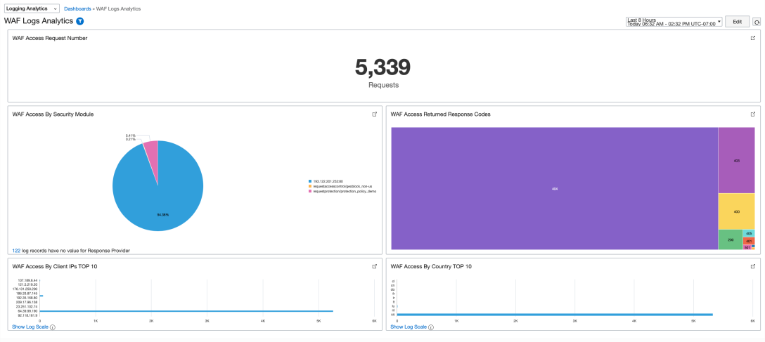
Access controls
Use the access controls to restrict or control access to your critical web applications, data and services. Examples:
Control access, based on HTTP header information. Block requests if the HTTP header contains specific names or values or allow traffic with proper HTTP regular expression.
Control access based on URL address matching or partial matching or match proper URL regular expressions.
Regional access control can be used to restrict users from certain geographies.

Slide 48
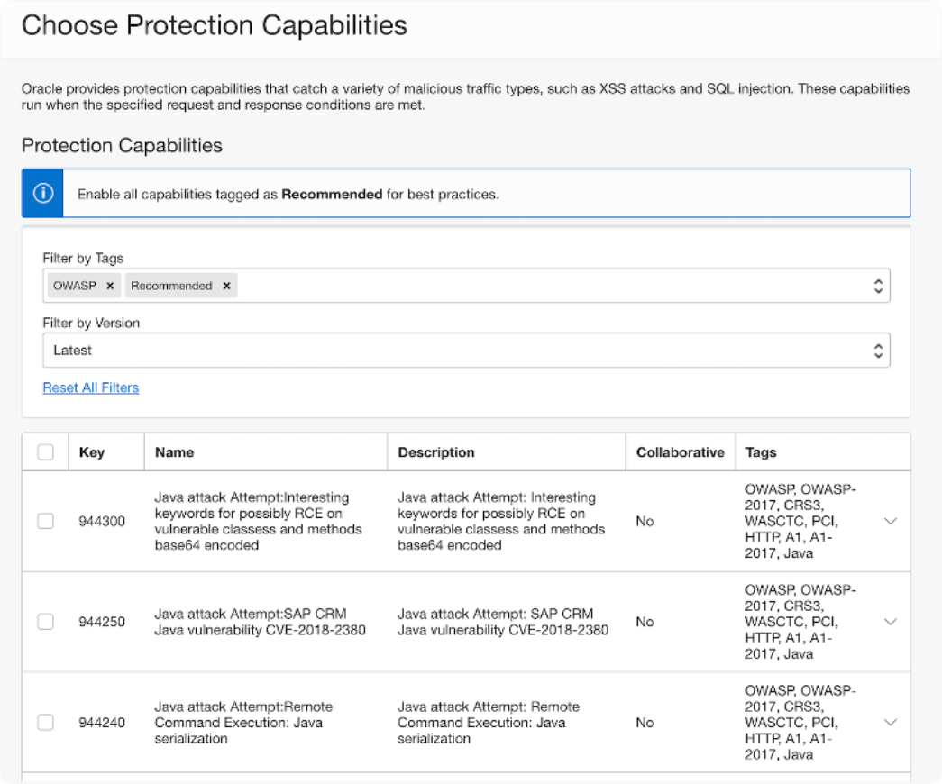
Protection rules
Use these rules to protect your critical web applications against malicious cyber-attacks from bad actors. Incoming requests are inspected to determine if it contains an attack payload as compared to industry-leading threat feeds.
Supports over 250 rule sets as well as
the Open Web Access Security Project (OWASP) rule sets.
WAF will block and/or alert on the requests: SQL injection, cross-site scripting, HTML injection and many more.

Slide 49
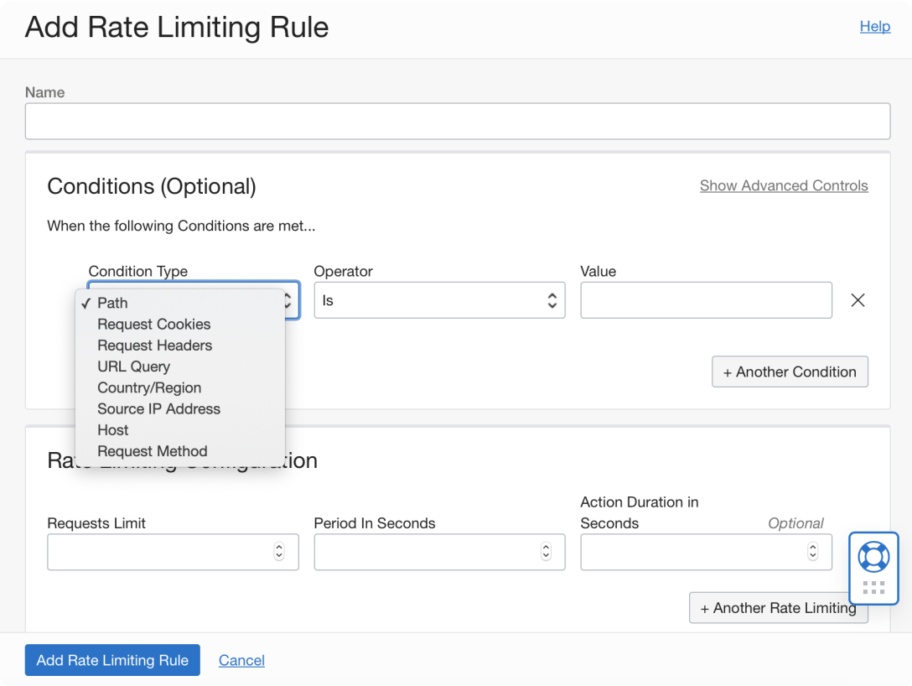
Rate limit rules
Rate limiting rules based on URL request parameters and client IP to protect against layer 7 DDOS attacks.
Allows inspection of HTTP request properties and limits the frequency of requests for each unique client IP address.

Slide 50

Bot management
Entity attributes and behavioral detection
Human interaction
Oracle WAF identifies normal usage patterns based on legitimate user behavior to the site.
The WAF will challenge with CAPTCHA or block requests when it detects abnormalities, or traffic exceeds defined interaction thresholds.
Device fingerprinting
Oracle WAF collects unique various characteristics about a device entity, generating a hashed signature. This hashed signature is then compared to other requests to determine the same signature is being leverages across different contexts.

Slide 51
Shared responsibility model for OCI WAF
Responsibility | Oracle | Customer
Onboard/configure the WAF policy for the web application | No | Yes
Configure WAF onboarding dependencies (DNS, ingress rules, network) | No | Yes
Provide high availability (HA) for the WAF | Yes | No
Monitor for distributed denial of service (DDoS) attacks | Yes | No
Keep WAF infrastructure patched and up-to-date | Yes | No
Monitor data-plane logs for abnormal, undesired behavior | Yes | Yes
Construct new rules based on new vulnerabilities and mitigations | Yes | No
Review and accept new recommended rules | No | Yes
Tune the WAF's access rules and bot management strategies for your traffic | No | Yes

Slide 52
What's New in OCI WAF
Include `${http.request.id}` in custom responses for faster troubleshooting and correlation (Release Notes).
Additional in-region protection rule sets and threat-intel feeds; easier tuning.
HTTP Request Body Inspection—buffers and scans request bodies.
*All features supported on both Edge and Flexible Load Balancers.

Slide 53
Simplified Pricing – 2025
First WAF instance + first 10 million requests/month are FREE for OCI commercial customers.
After free tier: charged per WAF instance/month and per 1 million
incoming requests.
Pricing identical for Edge and In-region WAF; pay-as-you-go or commit models.

Slide 54
OCI Network Firewall

Slide 55


Network Firewall Overview
Cloud-native Solution - Scalable cloud-native service, fully integrated with rich set of OCI platform capabilities, eliminating the need to manage additional third-party security infrastructure.
Advanced Threat Protection – Industry leading threat protection to help monitor and block malware, spyware and vulnerability exploits.
Layered Defense - Seamlessly integrates with Access Control Lists (ACLs), Network Security Groups (NSGs), and Web Application Firewalls (WAFs) to establish a Defense in Depth security strategy
Compliance – Helps meet compliance requirements and stringent security needs of regulated environments.
Next-Gen Network Firewall with Advanced Threat Protection
Notes:
Definition:
OCI Network Firewall is our cloud native L4/L7 firewall that is powered by Palo Alto. It provides you protection of threats, malware, spyware, and any vulnerability exploit as per to Palo Alto’s Threat Vault, which is database that contains the latest threats, malware, …etc. that Palo Alto Networks next-generation firewalls can detect and prevent.
Cloud-native Solution
And this is a huge advantage, OCI Network Firewall is fully managed by Oracle, so no need to worry about stuff like high availability and scalability.
Advanced Threat Protection
As I just mentioned, it provides an industry leading threat protection to help monitor and block malware, spyware and vulnerability exploits.
Layered Defense
So, cloud-native Firewall offers couple of features that we will get to know in the upcoming slides, such as security rules, IDS & IPS, URL filtering, …etc. But this service is part of layered security model which will have other services such as Web Application Firewall (WAF) to protect against L7 attacks such as SQL injection and Cross-site scripting. Also, Security Lists & NSGs for basic access control which we covered in the first session.
Compliance
Helps meet compliance requirements and stringent security needs of regulated environments.

Slide 56
Network Firewall Benefits
Segment and Filter network traffic
Protect against sophisticated cybersecurity threats
Enforce Compliance
Notes:
BENEFITS:
1. Segment and Filter network traffic
This is by dividing your network flows to restrict the traffic between different network environments according to different criteria such as source, destination or traffic type.
For example, you can use the firewall policies to filter what can access what in a way you segregate workloads or departments.
2. Protect against sophisticated cybersecurity threats
As I mentioned in the previous slide OCI Firewall will detect and prevent security threats like viruses, malware, and spyware that are identified in Palo Alto’s threat vault.
3. Enforce Compliance

Slide 57
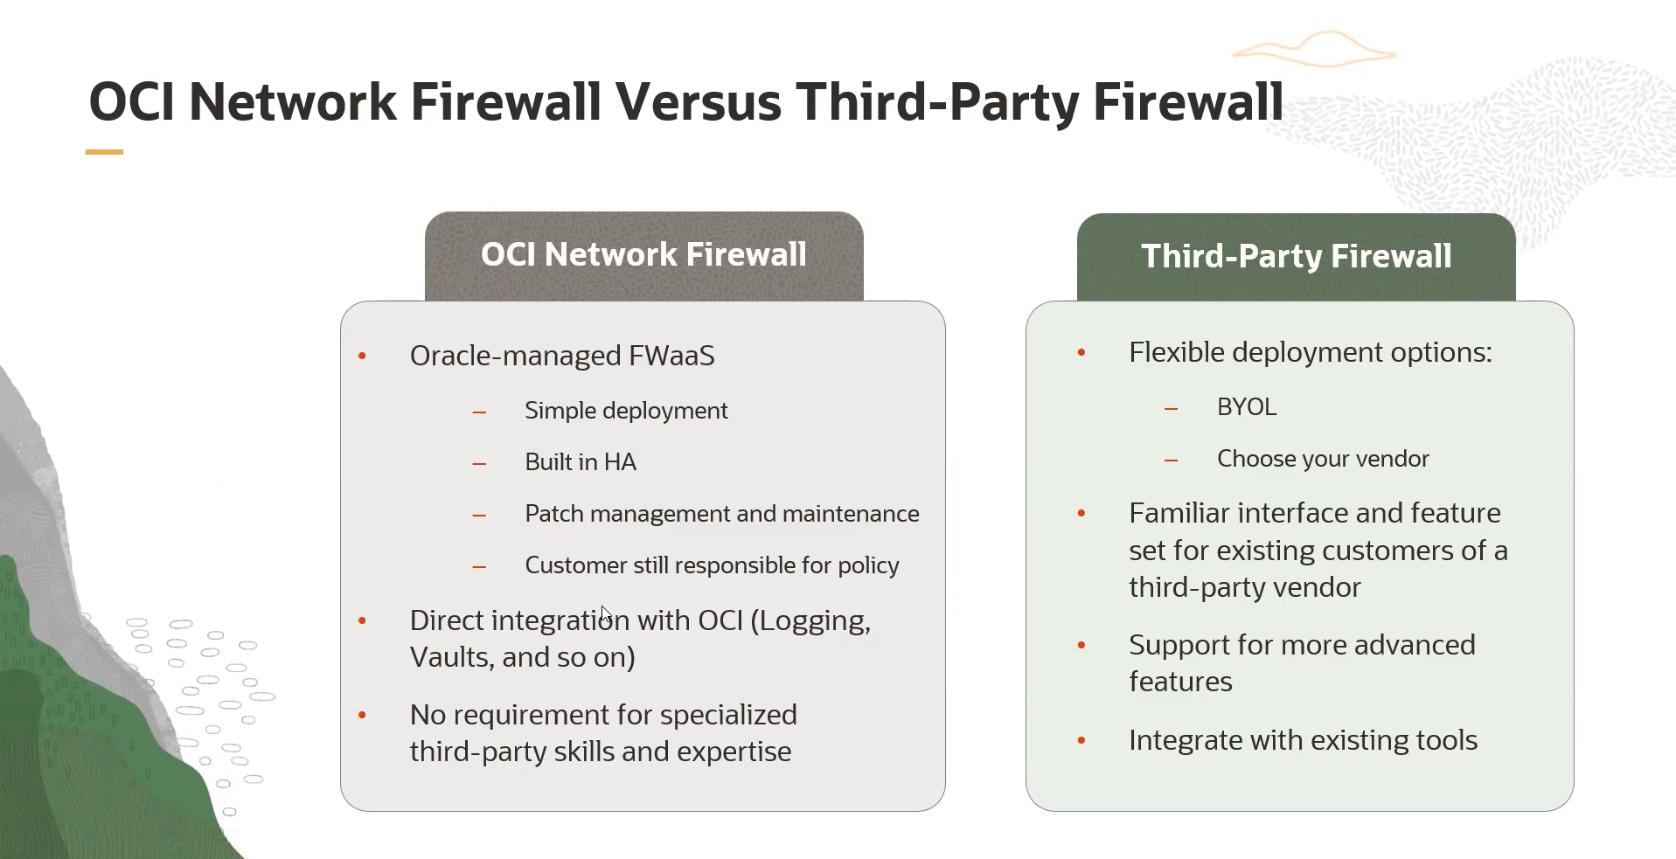
Notes:
Let’s do a quick comparison between OCI Network Firewall and Third-Party Firewall.
OCI Network Firewall.
A managed service, that means it has high availability built in, and also scalability, so you don’t have to worry about management of a firewall instance, all you have to do is configure your own policies.
The deployment is really simple and straightforward so you don't need any additional specific knowledge or experience to configure it, only OCI-related knowledge, so if you know OCI it would be easy.
Built-in or Direct integration with OCI native services such as Logging and Vaults for keys and so on…
Third-Party Firewall.
You can bring any NGFW of your choice. Upload a customer image of FortiGate or Palo Alto and so on… You will need to bring your own license into OCI.
You might prefer this option if you already have the needed experience to manage it and you are comfortable with it since it is a familiar interface.
What can be kind of a downside, that in case you want a NGFW, you will be responsible of the instance management, like HA & Scalability which you Oracle handles them for you in case of native firewall.
An advantage is that it offers you a little bit more advanced features that you can customize to your own needs. This depends on you, what features are you looking for exactly.

Slide 58
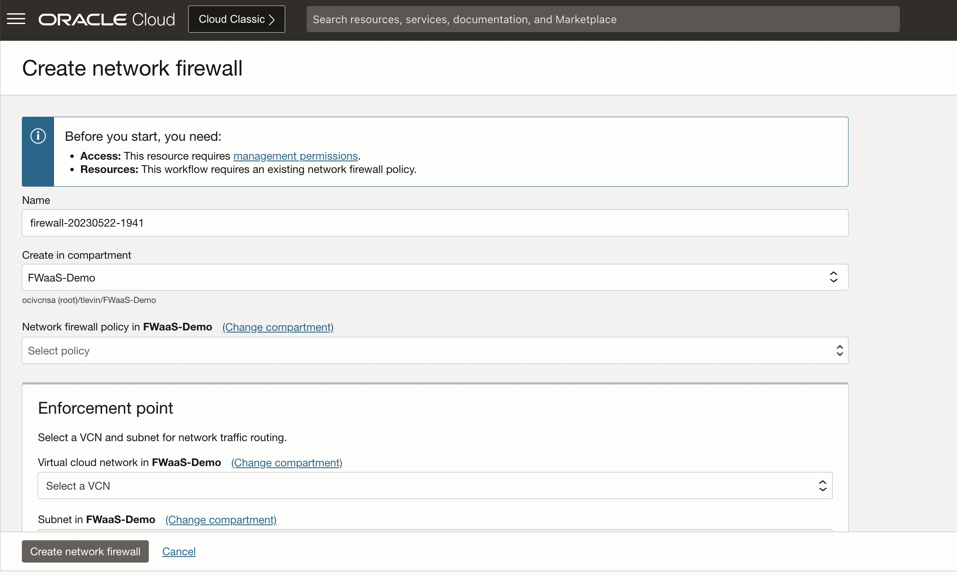
Cloud Native Solution
Best-of-breed Palo Alto network security with OCI-native experience.
Scalable cloud service supporting 4 -12.5 Gbps.
Highly available in both multi-AD and mono-AD regions.
Eliminates management of 3rd Party infrastructure.
Deep integration with OCI platform capabilities e.g.: metrics, logging, alerting etc.
Notes:
- Powered by Palo Alto.
- Throughput.
The current implementation of network firewall has 8Gbps throughput by default. This includes Ingress + Egress traffic, so this 4 Gbps in and 4 Gbps out.
For some customers, this might not be enough until they expect larger traffic flows so they would need larger throughput, this is why we provide the option to upgrade for enhanced throughput (that means 12.5 in 12.5 out , so 25 Gbps in total). Note that this is done by submitting a ticket so your tenancy be whitelisted. But before we get into these specifics it’s better to understand what’s your expectation when it comes to the throughput.
- Highly Available.
OCI FW is already highly available, scalable, and fault-tolerant, so you don’t need to manually configure high availability by adding more infrastructure for example. There are two deployment options when creating the firewall: either as a regional deployment across multiple availability domains or within a single availability domain across fault domains.
- It’s a native solution so no need to provision OCPUs Memory etc.
- It’s integrated with native OCI services such as metrics logging and alerting.

Slide 59
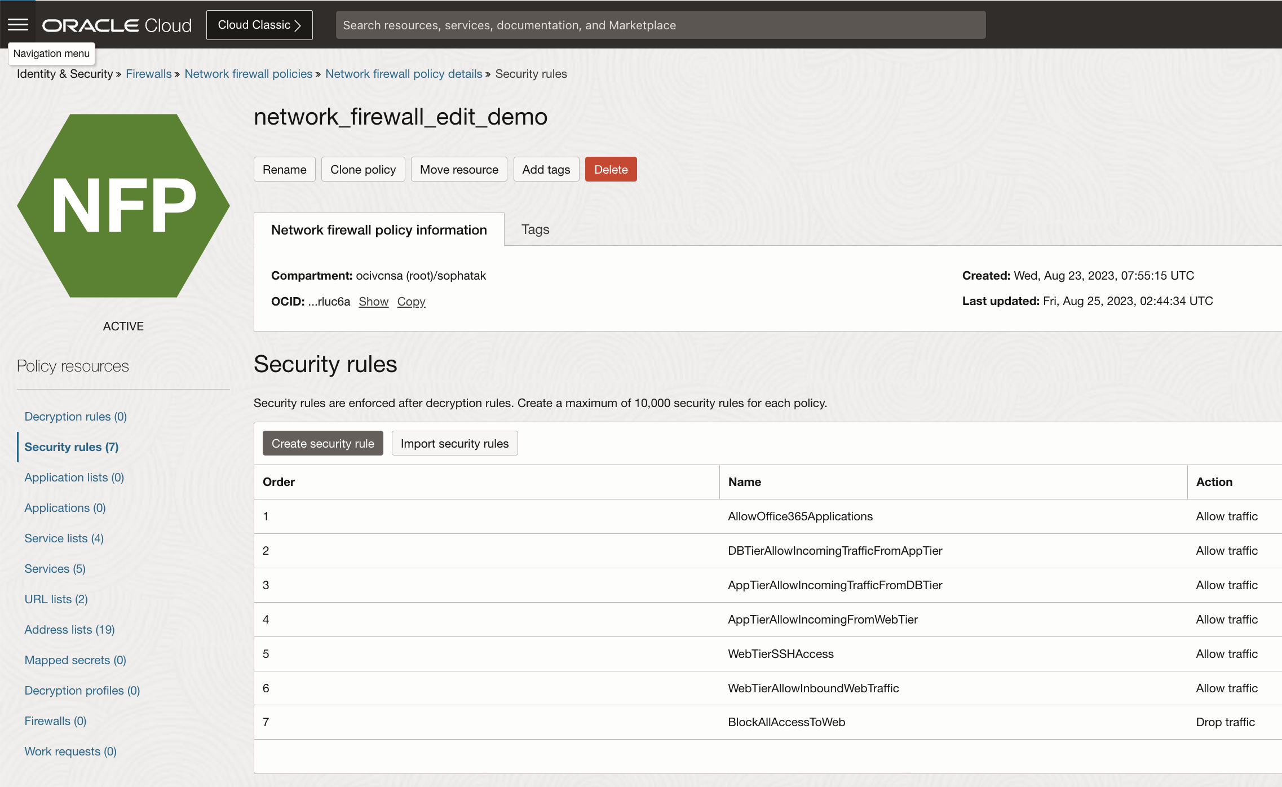
Access Control - Stateful Firewall rules
Allow or Deny stateful filtering rules based on 5-tuple information.
Customer-defined priority order for rules across multiple virtual networks.
Granular policy enforcement with traffic context-aware stateful firewall.
Enterprise Scale with 10K Firewall Rules, 20K IP Addresses.
Notes:
Stateful Network Filtering
Where the firewall automatically monitors traffic to allow or block connections based on their state.
As we know, there is SLs & NSGs. OCI Network Firewall offers the same functionality, which you can say it’s a basic access control list so you either allow or block traffic based on the source IP, source Port, destination IP, destination Port, and Protocol.
OCI FW offer you greater control comparing to SLs and NSGs.
Sec rules = 10K
IP Address Lists = 20K
For better performance, Oracle recommends that you don’t add stateful rules to the security list attached to the firewall subnet or include the firewall in an NSG containing stateful rules.

Slide 60
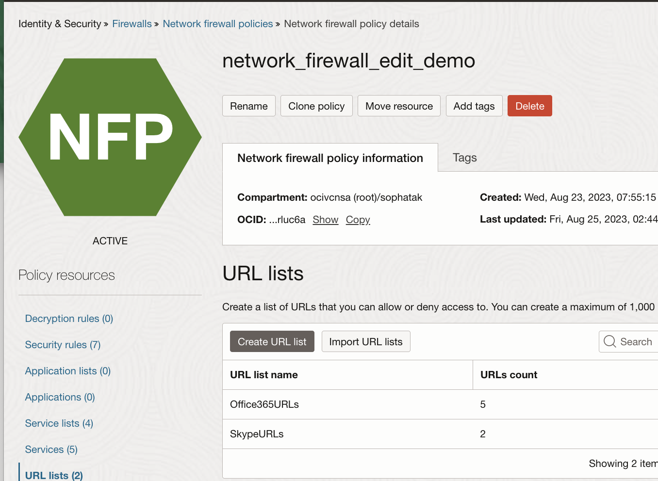
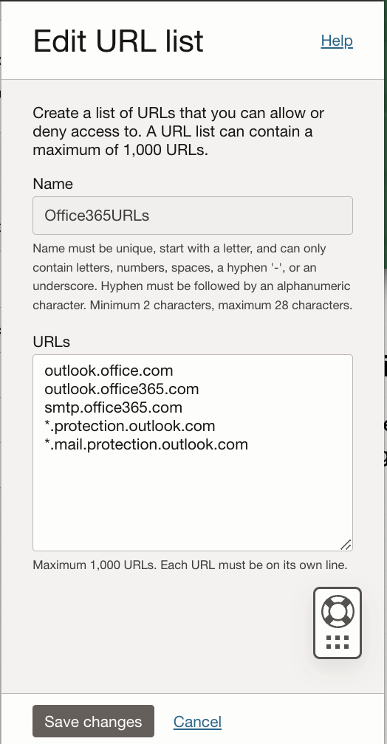
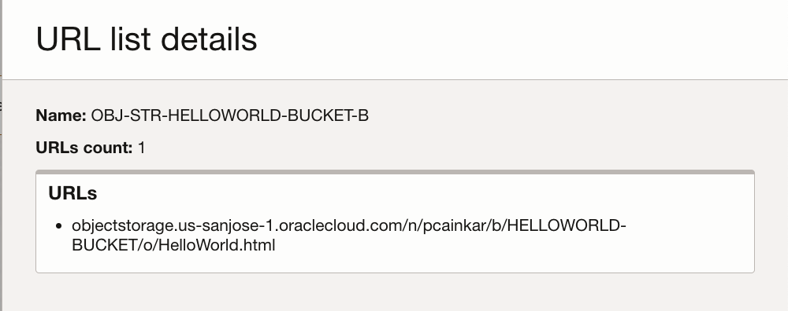
Advanced Threat Protection – URL Filtering
Block traffic to a user-defined list of URLs with support for wild cards.
Flexible enforcement for both inbound and outbound traffic.
Notes:
Custom URL filtering allow you to manage and monitor access to specific websites.
So, you restrict inbound and outbound HTTP and HTTPS traffic to a predefined list of fully qualified domain names (FQDNs). Just like the example you see in this slide. There is a support for wildcards, and subdomains as well.
Admins can use this to block access to restricted or nonwork related sites for example, so this enhances network security and enforces compliance with an organization’s acceptable use policies.
****SHOW THE EXAMPLES IN THE DOC*******

Slide 61
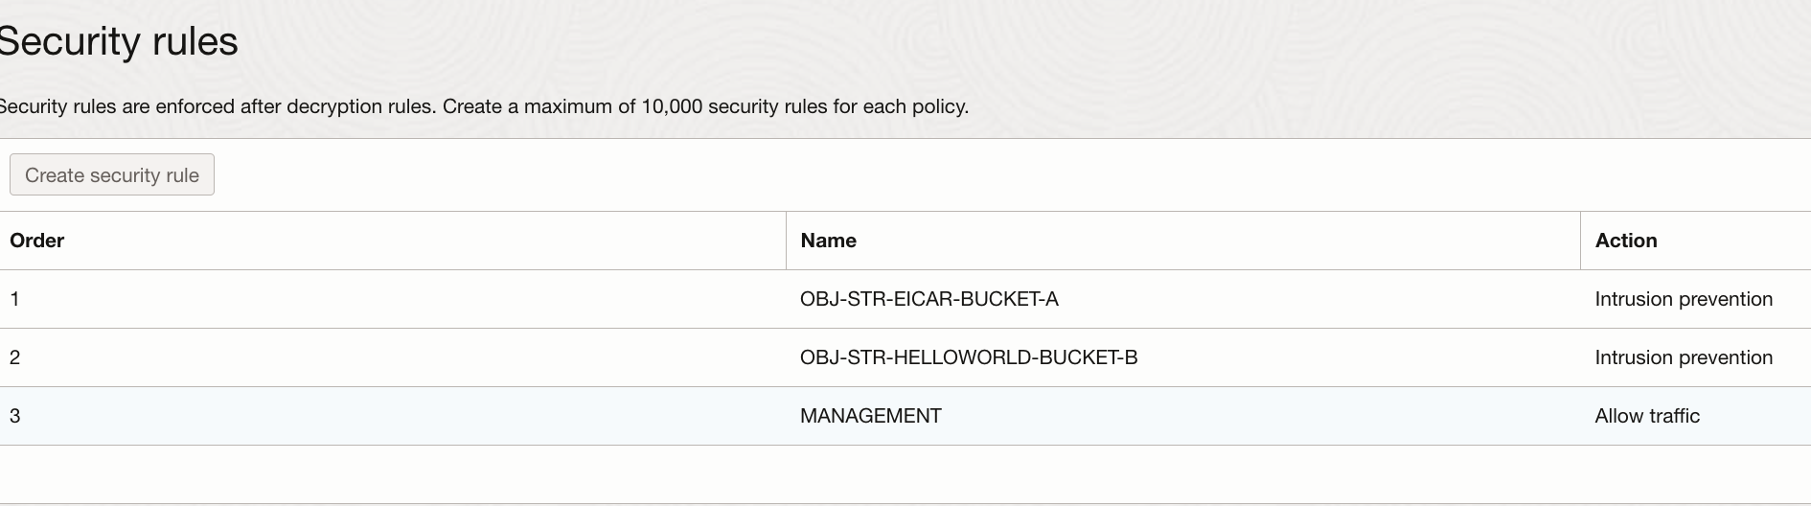
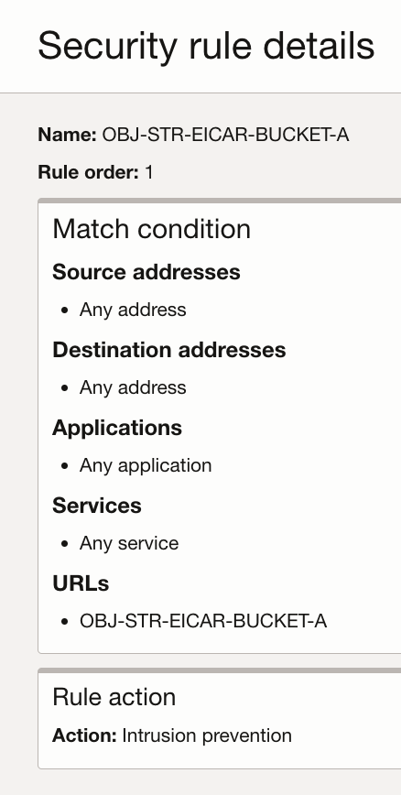
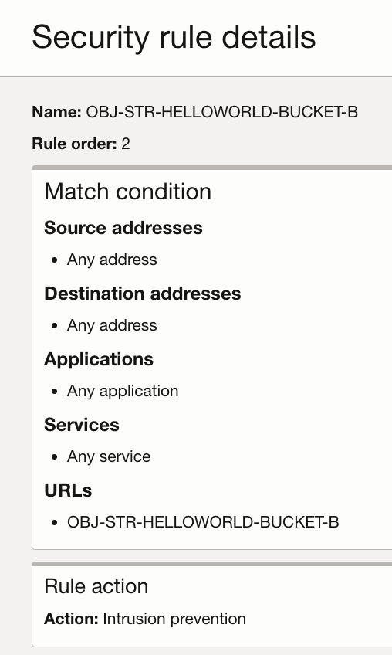
Intrusion Detection and Prevention
Detect and block known exploits, malware, malicious URLs, spyware, command and control (C2) attacks.
Palo Alto Networks security research team uses Advanced Threat Prevention powered by AI to equip the firewall with latest threat intelligence.
Supports threat detection and prevention on encrypted traffic.
Notes:
- Intrusion Detection System (IDS) monitors network traffic and analyzes it for suspicious patterns or known threats, generating alerts when potential intrusions are detected; but it does not take action to stop the threat. It focuses only on visibility and alerting.
- Intrusion Prevention System (IPS) not only detects suspicious activity but also actively blocks or mitigates threats in real time, preventing them from causing harm to the network. IPS emphasizes proactive defense and automated response.
When the action is set to "Intrusion Prevention" - What action will be taken? Does it block all severity signatures or specific?
For severity Med, High, and Critical, we will drop the traffic. For Low and Informational we will act based on the default settings of Palo Alto. These will be seen in the Threat Logs.
“””
SECURITY PROFILES: https://docs.paloaltonetworks.com/pan-os/10-2/pan-os-admin/policy/security-profiles
What are we lacking here ? . SACHIN WLL PROVIDE A LIST ? Check with him.
NOTE FROM THE TEAM ::: customers mostly use NGFW for NS traffic , and native for EW (not many customers use our FW for internet communication).
Because NGFW has some features we don’t support, C2S VPN, and S2S as some customers are not satisfied with our VPN BW, since NGFW depends on the VNIC for the BW.
“””
The threat signatures that the OCI Network Firewall uses are classified into the following categories:
Antivirus: Identifies different forms of malware and viruses, such as worms, trojans, and spyware downloads.
Antispyware: Monitors compromised hosts for C2 spyware attempting to connect or beacon to an external C2 server.
Vulnerability: Designed to detect and exploit system vulnerabilities.
These packages are automatically updated as part of the service, so you don’t have to worry about it.
PALO ALTO IMPORTANT RESOURCES:
Palo Alto provides a table of all possible signature categories by type—antivirus, spyware, and vulnerability—and content update (applications and threats or antivirus) that provides the signatures in each category. For more information, see their Threat Signature Categories documentation. https://docs.paloaltonetworks.com/advanced-threat-prevention/administration/threat-prevention/threat-signature-categories
With a free Palo LIVE community account, you have access to Palo Alto’s threat vault, https://www.paloaltonetworks.com/blog/threat-vault/
a database that contains the latest threats, such as vulnerabilities, exploits, viruses, and spyware, that Palo Alto Networks next-generation firewalls can detect and prevent.
Since OCI Network firewall uses the Palo Alto firewall engine for IDS/IPS, you can learn more about how Palo Alto implements it here: https://www.paloaltonetworks.com/apps/pan/public/downloadResource?pagePath=/content/pan/en_US/resources/whitepapers/palo-alto-networks-approach-to-intrusion-prevention

Slide 62
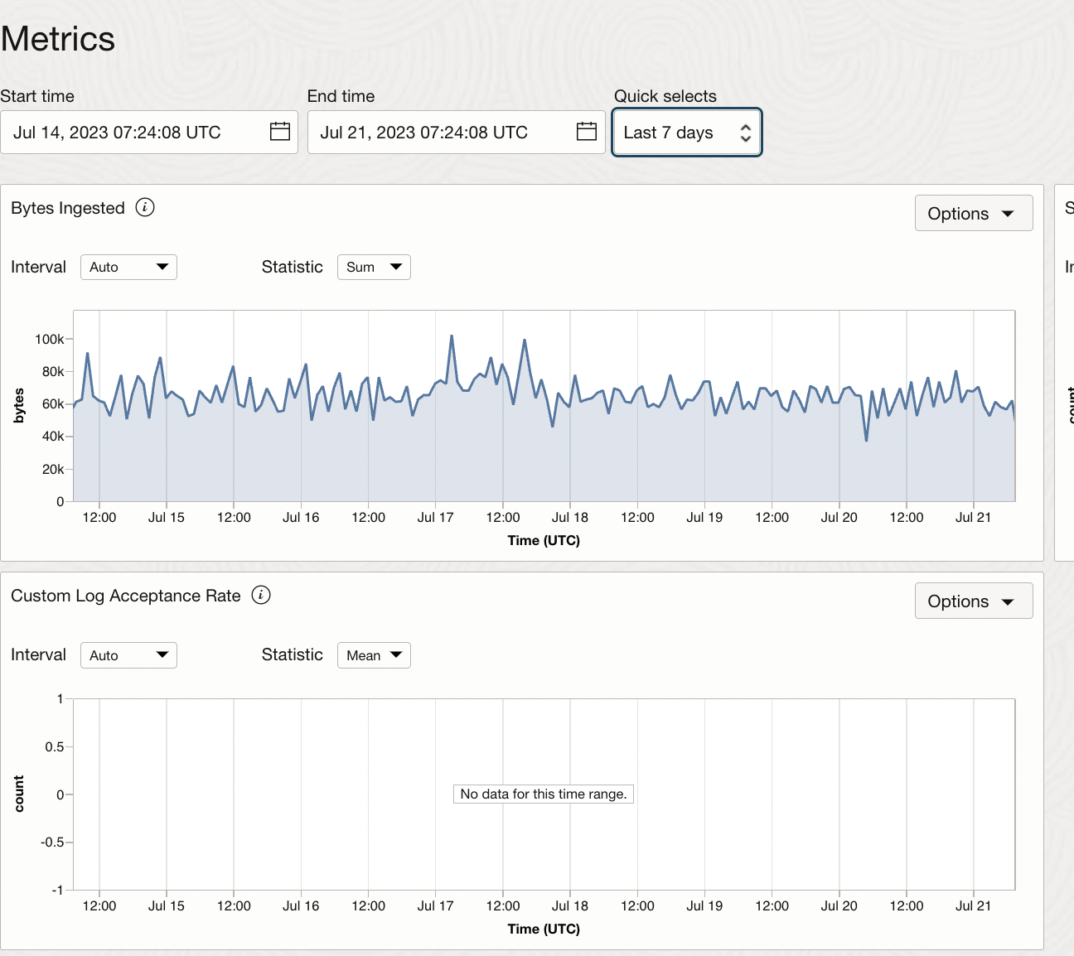
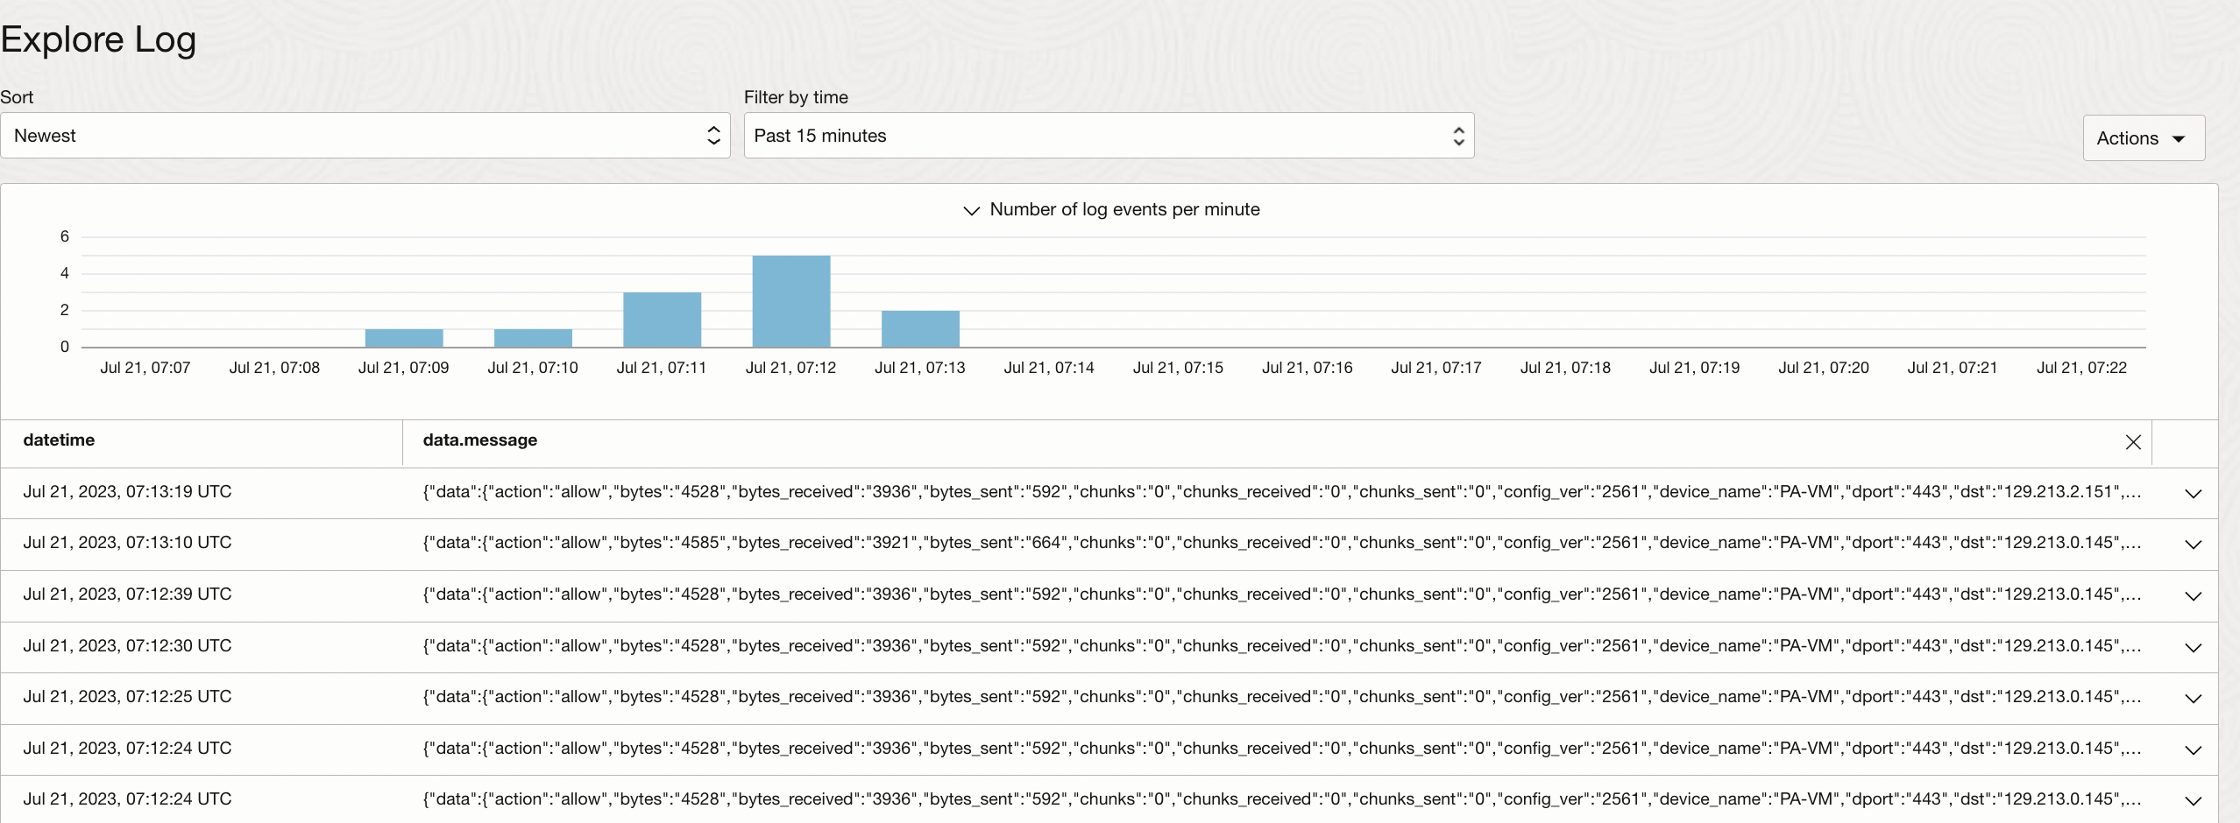
Logging and Observability
Network Firewall metrics help monitor the health, capacity, and performance of firewall policies and resources. Alarms and Notifications can be configured to notify you when metrics meet alarm-specified triggers.
Network Firewall logs (integrated with OCI logging) enable you to understand what rules and the countermeasures triggered by requests.
Notes:
And we said earlier, OCI FW integrates with logging and analytics.
It helps you monitor the health and performance of firewall policies. You can send alarms and notifications to specific resources once metrics are met. The Network Firewall logs enables you to understand what is going on.
You can have a deep dive review of the logging that takes place and analyze any particular pattern.
Threat log: Provides details on received firewall threats.
Traffic log: Provides details on traffic passing through the firewall.
Available in all the regions of the commercial realms

Slide 63
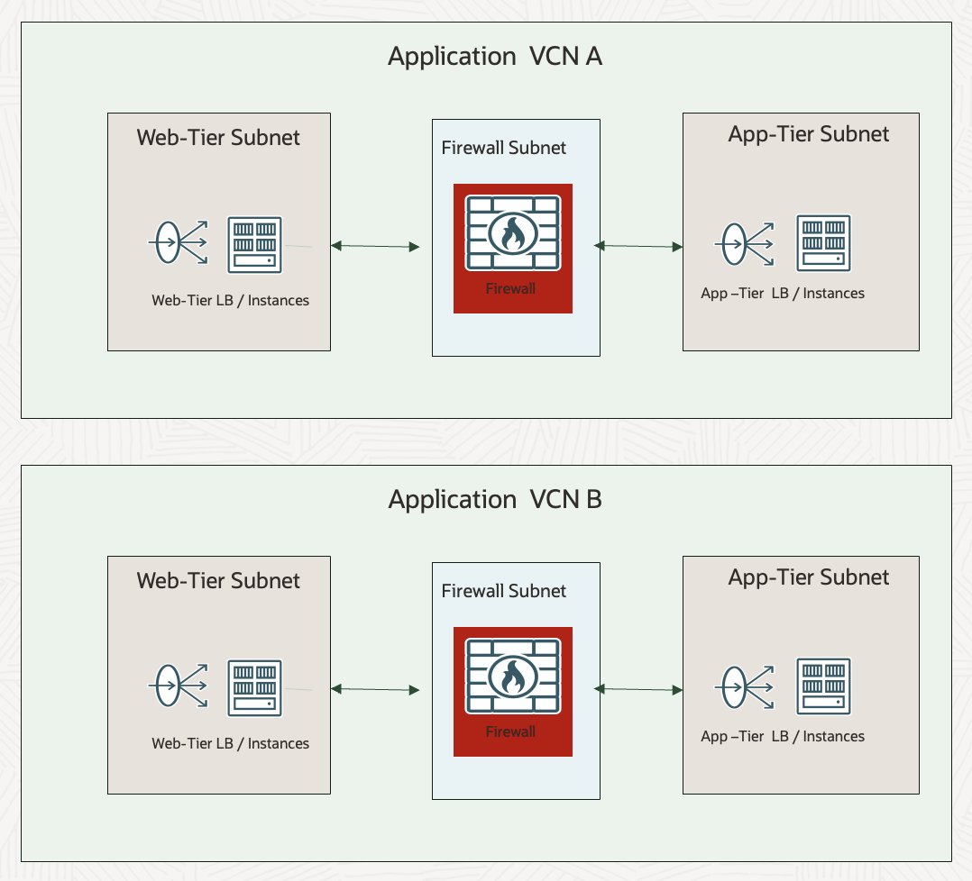
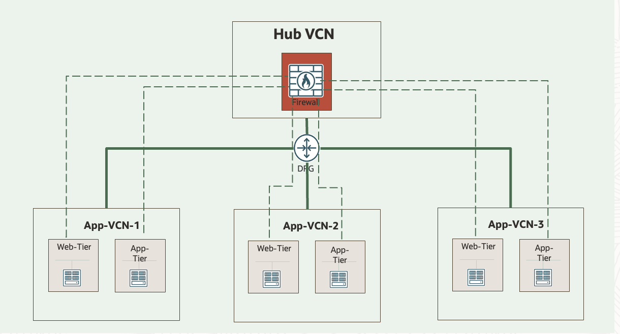
Flexible Deployment Topologies
Centralized Deployment
Network Firewall is deployed in a Hub VCN and connected to spoke VCNs through DRG.
Distributed Deployment
A dedicated Network Firewall deployed in each VCN.

Slide 64
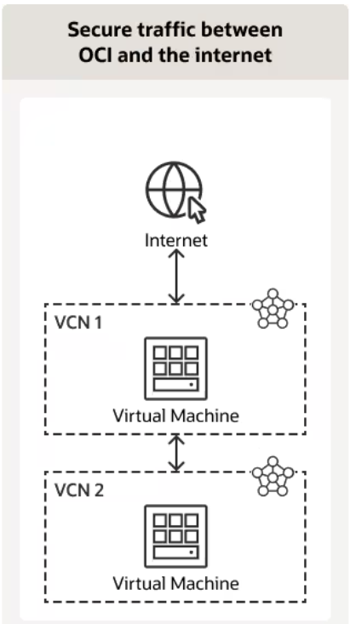
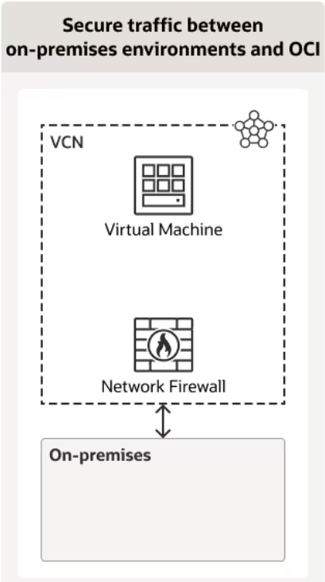
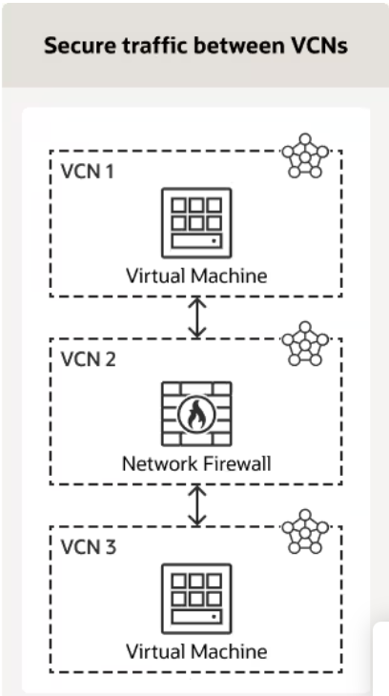
Use cases for OCI Network Firewall

Slide 65
Domain Name System (DNS)

Slide 66
The hierarchical and decentralized naming system used to identify computers, services, and other resources reachable through the Internet or other Internet Protocol (IP) networks.
The resource records contained in the DNS associate domain names with other forms of information. These are most commonly used to map human-friendly domain names to the numerical IP addresses.
DNS:
“Domain Name System”

Slide 67


DNS Introduction
What is the IP for www.example.com?
www.example.com is 10.1.1.10
Compute Instance
DNS Server

Slide 68
DNS Introduction
Root Servers (“.”)
3
What is the IP for www.example.com?
Ask com.
(And if you don’t know, go figure it out)
2
1
What is the IP for www.example.com?
What is the IP for www.example.com?
4
TLD Servers for com.
8
5
www.example.com. is 10.1.1.10
6
Ask example.com.
Compute Instance
DNS Server
What is the IP for www.example.com?
www.example.com. is 10.1.1.10
7
Customer DNS Servers

Slide 69
DNS Introduction
Root Servers (“.”)
3
What is the IP for www.example.com?
Ask com.
(And if you don’t know, go figure it out)
2
1
What is the IP for www.example.com?
What is the IP for www.example.com?
Authoritative
4
TLD Servers for com.
8
5
www.example.com. is 10.1.1.10
6
Ask example.com.
Compute Instance
DNS Server
What is the IP for www.example.com?
www.example.com. is 10.1.1.10
7
Customer DNS Servers
Recursive

Slide 70
DNS Introduction – Common Resource Record Types
A – An address record.
AAAA – An IPv6 address record.
ALIAS – Non-standard, used to redirect requests.
CNAME – Canonical Name, refers client to use to another name.
MX – Mail Exchanger, the mail servers for a domain.
NS – Name servers, the name servers for domain or subdomain.
PTR – Pointer, enables (reverse) resolution of IP addresses to names.
SOA – Start of Authority, contains primary name server, responsible contacts, serial number.
TXT – Contains text information, various uses including domain validation.

Slide 71
OCI Public & Private DNS
Public DNS Zones hold the trusted DNS records that will reside on Oracle Cloud Infrastructure's nameservers. You can create public zones with publicly available domain names – reachable on internet (need to register with a DNS registrar).
Private DNS zones contain domain names that resolve DNS queries for private IP addresses within a VCN.
You can create private zones to define your own domain name for private address resolution.
Can also combine VCNs for private DNS resolution over several VCNs.
Private DNS for name resolution within OCI
Notes:
Network Load Balancers are used to route TCP (or Layer 4) traffic.

Slide 72
Domain Name System (DNS)
1. Private DNS

Slide 73


Virtual Cloud Network DNS
Each VCN has one DNS Resolver.
It is possible to create VCNs with DNS disabled.
Available at 169.254.169.254
Resolves oraclevcn.com names within a VCN.
Resolves DNS names on the Internet.
169.254.169.254
DNS Resolver
VCN: Prod
(10.0.1/24)
instance1
instance2
instance3
Subnet: Web
Subnet: App
Example:
instance1.web.prod.oraclevcn.com
Default Endpoint

Slide 74
Private DNS
Continuation of VCN DNS capabilities.
Available at 169.254.169.254
By default:
Resolves oraclevcn.com names within a VCN.
Resolves DNS names on the Internet.
Adds support for:
Private Zones and Views.
Endpoints.
Rules.
169.254.169.254
DNS Resolver
VCN: Prod
(10.0.1/24)
instance1
instance2
instance3
Subnet: Web
Subnet: App
Example:
instance1.web.prod.oraclevcn.com
Default Endpoint

Slide 75
Private DNS – Private Views
Allows hosting of custom DNS zones.
Create custom DNS records in custom zone.
Automatically-created DNS records still land in protected DNS zone for subnet in oraclevcn.com.
Not possible to assign custom zone to subnet.
Custom zones can be shared by multiple VCNs.
In the same region.
Private DNS hosts all data for zone.
Cannot delegate sub-zones.
Cannot be secondary to zone hosted by non-Private DNS server.
Cannot have non-Private DNS secondary server.
169.254.169.254
DNS Resolver
VCN: Prod
(10.0.1/24)
instance1
instance2
instance3
Subnet: Web
Subnet: App
Example:
instance1.web.prod.oraclevcn.com
web-prod-1.oci.example.com
Default Endpoint

Slide 76
Private DNS – Endpoints
Endpoints attach Private DNS resolvers to a subnet in a VCN.
Listening Endpoints receive requests from clients and remote DNS servers.
Forwarding Endpoints are used to send requests to remote DNS servers.
There must be connectivity between the endpoint and relevant clients or servers.
Use DRGs for cross-VCN connectivity.
Be mindful of overlapping VCN CIDR ranges.
Traffic must be permitted by security lists.
10.0.1.253
10.0.1.10
169.254.169.254
DNS Resolver
VCN: Prod
(10.0.1/24)
instance1
instance2
instance3
Subnet: Web
Subnet: App
Example:
instance1.web.prod.oraclevcn.com
web-prod-1.oci.example.com
Default Endpoint
Forwarding Endpoint
Listening Endpoint

Slide 77
Private DNS – Rules
Directs requests to a remote DNS resolver.
Only used if resolver is not authoritative.
Remote DNS server could be in another VCN or on-prem.
Up to 10 rules direct DNS zone to remote Servers.
10.0.1.253
10.0.1.10
10.0.2.253
10.0.2.10
169.254.169.254
DNS Resolver
169.254.169.254
DNS Resolver
VCN: Prod
(10.0.1/24)
VCN: Dev
(10.0.2/24)
Rules in Prod VCN
instance1
instance2
instance3
instance1
instance2
instance3
Domains | Source (Forwarding Endpoint) | Destination (Listening Endpoint)
dev.oraclevcn.com | 10.0.1.253 | 10.0.2.10
Subnet: Web
Subnet: App
Subnet: Web
Subnet: App
Rules in Dev VCN
Domains | Source (Forwarding Endpoint) | Destination (Listening Endpoint)
prod.oraclevcn.com, oci.example.com | 10.0.2.253 | 10.0.1.10
Example:
instance1.web.prod.oraclevcn.com
web-prod-1.oci.example.com
instance3.app.dev.oraclevcn.com
Default Endpoint
Forwarding Endpoint
Listening Endpoint

Slide 78
Private DNS – Demo
Create oci.example.com Private View in Prod VCN.
Create web-prod-1.oci.example.com DNS record.
Create following DNS rules.
10.0.1.253
10.0.1.10
10.0.2.253
10.0.2.10
169.254.169.254
DNS Resolver
169.254.169.254
DNS Resolver
VCN: Prod
(10.0.1/24)
VCN: Dev
(10.0.2/24)
Rules in Prod VCN
instance1
instance2
instance3
instance1
instance2
instance3
Domains | Source (Forwarding Endpoint) | Destination (Listening Endpoint)
dev.oraclevcn.com | 10.0.1.253 | 10.0.2.10
Subnet: Web
Subnet: App
Subnet: Web
Subnet: App
Rules in Dev VCN
Domains | Source (Forwarding Endpoint) | Destination (Listening Endpoint)
prod.oraclevcn.com, oci.example.com | 10.0.2.253 | 10.0.1.10
Example:
instance1.web.prod.oraclevcn.com
web-prod-1.oci.example.com
instance3.app.dev.oraclevcn.com
Default Endpoint
Forwarding Endpoint
Listening Endpoint

Slide 79
Domain Name System (DNS)
2. Public DNS

Slide 80
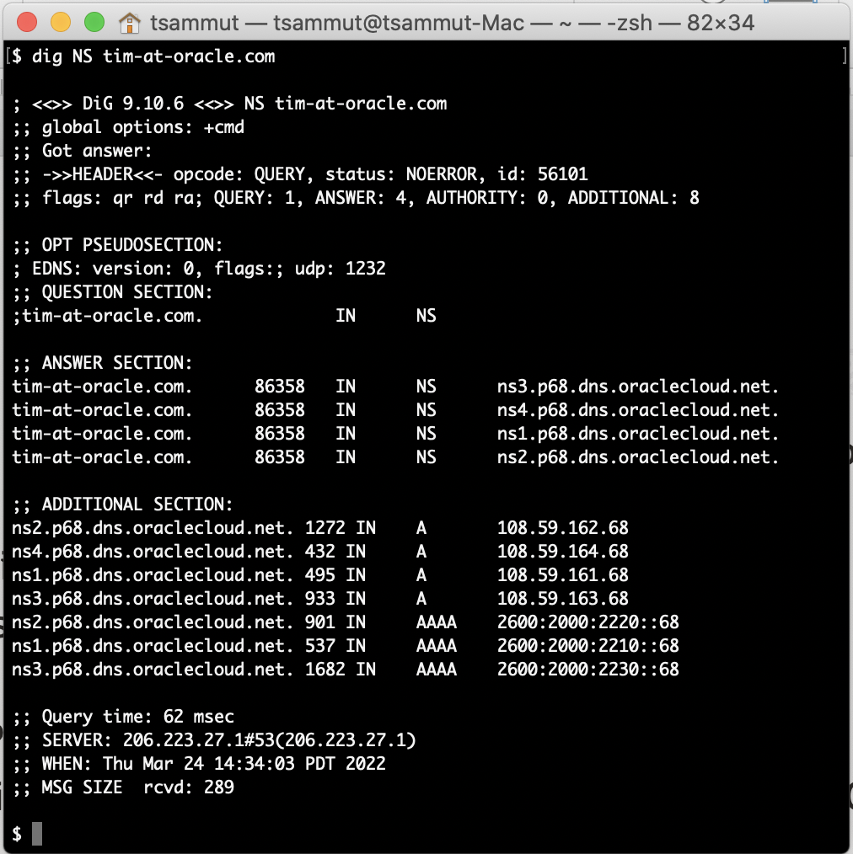
Public DNS
test
Provides Authoritative DNS service functionality for public DNS zones.
Served via anycast from OCI’s global commercial regions.
Supports import in standard BIND zone data format.
OCI for Primary + Secondary DNS.
Hosting a customer’s public DNS domains entirely in OCI.
OCI for Secondary DNS
Provides fault tolerance for a customer’s public DNS zones hosted on-prem or with other providers.
test
test
test
test
test

Slide 81
Public DNS – DNS Traffic Management Steering Policies
Provides intelligence DNS responses based on user-configured policies
Failover: Integrates with the OCI Health Checks service to direct clients towards a primary resource while healthy and then failing over to backup resources.
Load Balancing: Distributes load equally or using user-defined weighting across multiple resources. Uses OCI Health Checks to detect and remove failed resources from service.
Geolocation Steering: Directs users based on the user’s source geography. For example, direct users in Europe to eu.customer.com.
ASN Steering: Directs users based on the user’s source BGP ASN.
IP Prefix Steering: Directs users based on the user’s source IP address.

Slide 82
IP Management

Slide 83
Bring Your Own IP (BYOIP)
Let you manage your IPv4 CIDR blocks and IPv6 prefixes to align with your existing security, management, and deployment policies and achieve:
Solution continuity and hardcoded dependencies: Your VCN is an extension of your public Internet presence, without needing to reinvent policies and management processes. If you have IP addresses hard-coded in devices or built architectural dependencies on specific IP addresses, using BYOIP you have a smooth migration to Oracle Cloud Infrastructure.
IP pool management: Some network administrators require the ability to summarize groups of IPv4 addresses into pools and to create resources for deployment such as load balancers, firewalls, or web servers. IP Pool management provides tools to manage reserved public IPv4 addresses. IPv6 does not use IP Pool management.
IP reputation: Some internet services rely on a contiguous IP address space (such as a full span of IP addresses from 1 through 255) and act as a trusted contact point between services such as major email service providers and mail delivery systems.
Notes:
Network Load Balancers are used to route TCP (or Layer 4) traffic.

Slide 84
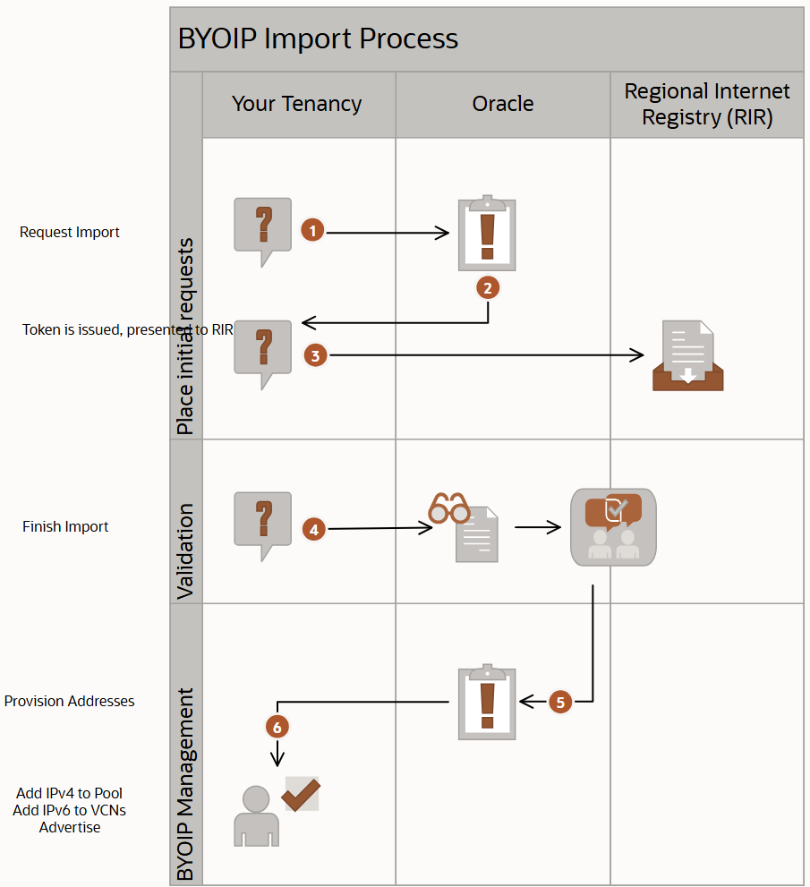
Bring Your Own IP (BYOIP)
Notes:
Network Load Balancers are used to route TCP (or Layer 4) traffic.

Slide 85
Bring Your Own ASN (BYOASN)
Autonomous System Number (ASN) is a unique number assigned to a network over the internet enabling different networks to exchange routing information with each other using the Border Gateway Protocol (BGP). ASN is also used for security policies to identify network traffic source, enabling you to filter traffic based on the originating network.
Bring your own ASN to Oracle Cloud Infrastructure and use your existing ASN within the OCI environment.
Currently supported for ARIN, RIPE and APNIC Regional Internet Registries (RIR) and is available across all OCI commercial regions.
Notes:
Network Load Balancers are used to route TCP (or Layer 4) traffic.

Slide 86
BYOASN Key Capabilities
No limit on the number of ASNs you can import into OCI.
Import same ASN across multiple regions.
You can prepend the ASN up to 20 times to influence the route preference, which can be used when setting up an active-standby or disaster recovery site.
Support for both 2-byte and 4-byte ASN.
Support for Console UI, CLI, API and Terraform.
Notes:
Network Load Balancers are used to route TCP (or Layer 4) traffic.

Slide 87
Reserved Public IPs

Slide 88
What Are Reserved Public IPs ?
Ephemeral: This is temporary public IP address that is assigned to resources for the lifetime of the resource. For example, once a VM instance with an ephemeral IP address is destroyed, the ephemeral public IP address is returned to the OCI IP pool for re-use by another device.
Reserved: A persistent public IP address can be assigned, unassigned, and re-assigned to resources. For example, you can unassign the reserved public IP address and then reassign it to another instance whenever you want to.

Slide 89
Reserved Private IPs

Slide 90
What Are Reserved Private IPs ?
Static IPv4/IPv6 addresses you can take out of the dynamic pool inside a subnet.
Remain assigned across reboots; can be re-attached to any VNIC in the same subnet.
Avoids IP churn and simplifies DNS / firewall rules.

Slide 91






Reserved Private IPs – Key Use Cases
Failover / HA – move the IP to a standby instance in seconds.
Blue-Green Deployments – swap IP between versions with zero DNS change.
Maintain Consistent IPs Across Lifecycle – Reuse reserved IPs across replacements or re-creations of instances.
Static IPs for Licensing or Compliance – Some apps require fixed IPs for licensing, auditing, or compliance.
Testing & DevOps Scenarios – Use reserved IPs to test configurations before VM creation. Helpful in CI/CD pipelines, replicated environments, etc.
Audit & Compliance – Predictable IPs simplify security policies.

Slide 92
Reserved Private IPs – Feature Highlights
Supports both IPv4 and IPv6 reserved addresses.
Integrates with IP Address Insights for subnet-level visibility.
Console, CLI, and Terraform support on day 1.

Slide 93
Reserving an IP
Navigate to Networking>Virtual Cloud Networks>VCN Name>Subnet Details>IPv4 addresses or IPv6 addresses.
Click Add Reserved IP Address, IPv4 or IPv6 and add a specific address.
Provide a name & description (and optionally hostname), then add reserved IPv4 or IPv6 address.
Attach the reserved IP to a VNIC in the same subnet.
You can reserve existing subnets private IPs to make sure is not going to be reused in the future by other resources.

Slide 94
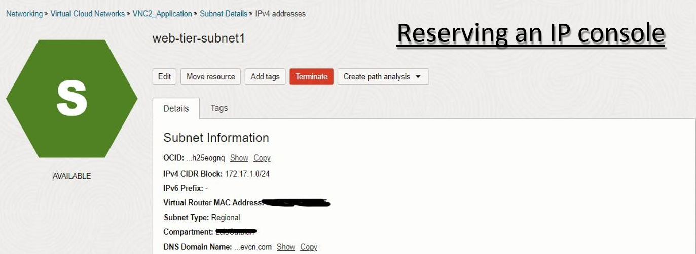
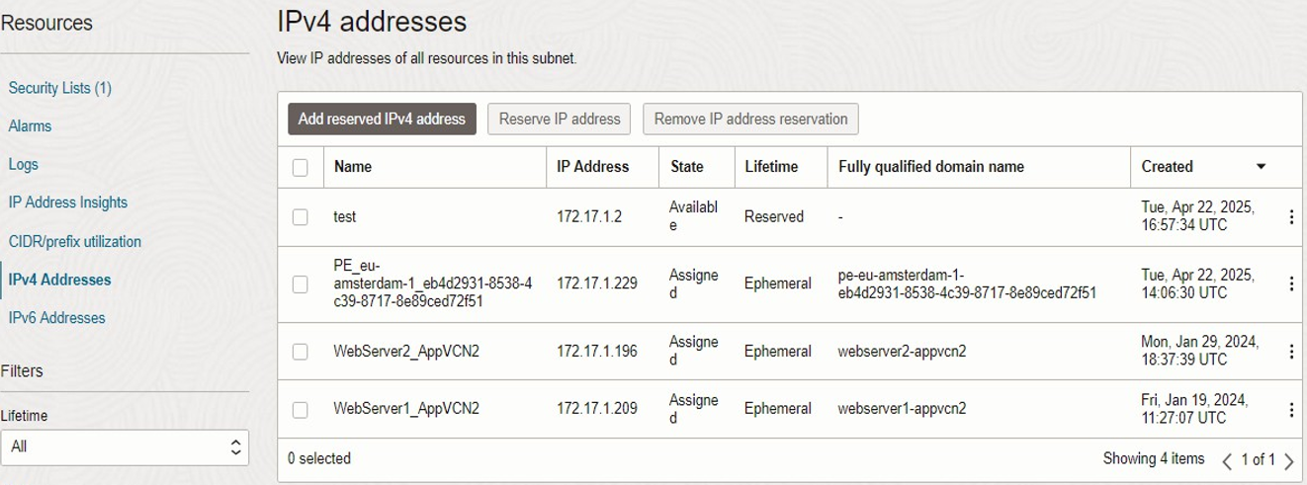

Slide 95
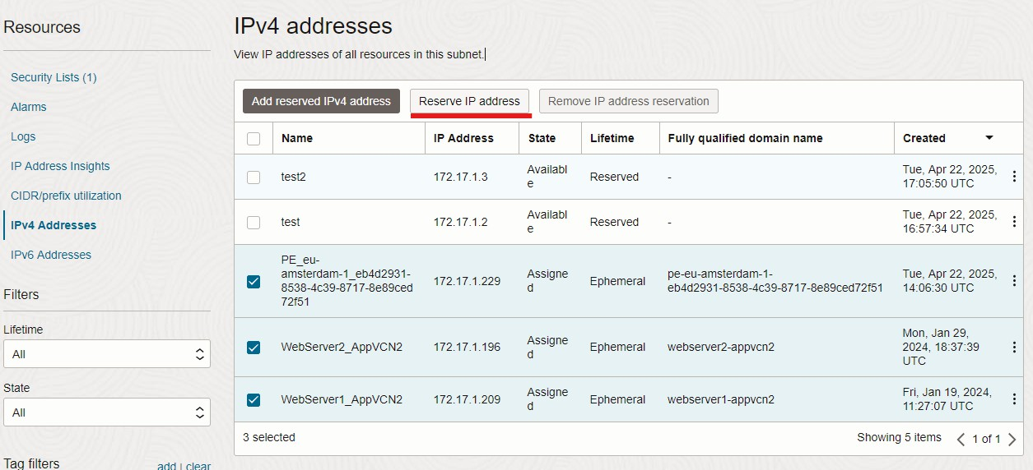
Reserving Existing Ephemeral in Bulk
To reserve all IP addresses in bulk, select the Name checkbox, and click Reserve IP address. You can also select several IP addresses individually.

Slide 96




Reserved Private IPs – Best Practices
Reserve IPs early in project design to avoid mid-stream renumbering.
Periodically audit unused reserved IPs to free them for other teams.
Remember: reservations are **subnet-scoped**, not VCN-wide.
Moving an IP briefly interrupts traffic—plan maintenance windows.

Slide 97
WAN Connectivity (On-prem/OCI/Multicloud)

Slide 98
Dynamic Routing Gateway (DRG)

Slide 99

Dynamic Routing Gateway (DRG)
A virtual router that provides a path for private traffic between your VCN and destinations other than the internet.
DRG is a standalone object. You must attach it to a VCN. VCN and DRG have n:1 relationship.
You can use it to establish a connection with your on-premises network via IPSec VPN or FastConnect (private, dedicated connectivity).
After attaching a DRG, you must add a route for the DRG in the VCN's route table to enable traffic flow.

Slide 100

DRG Routing Engine
1) An attachment connects a DRG to another network resource:
Virtual Cloud Network (VCN).
Remote Peering Connection (RPC).
FastConnect (Virtual Circuit).
IPSec VPN.
It enables traffic routing between OCI networks and external networks through the DRG.
2) Each “Attachment” has a route table assigned, which directs ingress traffic to a specific egress attachment.

Slide 101
Site-to-Site VPN

Slide 102

VPN Basics
VPN (Virtual Private Network): using a public network to make end to end connection between two private networks in a secure fashion.
Tunnel: A way to deliver packets securely through the internet to private RFC 1918 addresses.
Authentication: Provides a mechanism to authenticate who you are.
Encryption: Packets need to be encrypted, so they cannot be sniffed over the public internet.
Static routing: Configure a router manually to send traffic to a particular destination in preconfigured directions.
Dynamic routing: Use a routing protocol such as BGP to figure out what paths traffic should take.
Tunnel
VPN Connection
Private
Network 1
Private
Network 2
Internet
VPN
Router
VPN
Router
Notes:
Network Load Balancers are used to route TCP (or Layer 4) traffic.

Slide 103
Site-to-Site VPN
A managed OCI service that encrypts your data and tunnels it through the public internet for enhanced security and privacy with an IPSec VPN connection.
Bandwidth depends on the customer’s access to the Internet and general Internet congestion (Typically less than 250 Mbps – but your mileage may vary).
OCI provisions redundant VPN tunnels located on physically and logically isolate tunnel endpoints.
Free service.
Notes:
Network Load Balancers are used to route TCP (or Layer 4) traffic.

Slide 104



Site-to-Site VPN
Use Cases
Customer Proof of Concepts usually start as a VPN and then morph into FastConnect designs.
Connect your headquarters branch locations, and private datacenters to the Oracle Cloud so all of your offices can access applications.
Securely connect your existing infrastructure to the cloud or connect multiple clouds.
Use VPN as a backup connection for FastConnect.
Tunnel 1
Tunnel 2
Check Point
Cisco
FortiGate
Palo Alto
Libreswan
Openswan
Strongswan
Juniper
WatchGuard
Yamaha
Furukawa Electric
NEC
Verified CPE Devices
Notes:
Network Load Balancers are used to route TCP (or Layer 4) traffic.

Slide 105
Site-to-Site VPN
Workflow
Create a Virtual Cloud Network (VCN).
Create a Dynamic Routing Gateway (DRG).
Attach DRG to your VCN.
Update VCN routing to send traffic to DRG.
Create a CPE Object and add on-premises router (firewall) Public IP address.
Create an IPsec Connection between CPE and DRG and provide a Static Route or use BGP routing.
Configure on-premises CPE Router. Make sure to configure the appropriate IPSec parameters on both ends.
Tunnel 1
Tunnel 2
Notes:
Network Load Balancers are used to route TCP (or Layer 4) traffic.

Slide 106
FastConnect

Slide 107
FastConnect
Dedicated, private, secure network connectivity from customer locations to OCI via integrated Network Partners.
Port speeds of 1Gbps, 10Gbps, 100Gbps, or 400Gbps are available.
Recommended to use 2x for redundancy.
Use BGP protocol.
No charges for inbound/outbound data transfer. FastConnect only charges a per-hour port fee based on the port speed.
Notes:
Network Load Balancers are used to route TCP (or Layer 4) traffic.

Slide 108
FastConnect
Use Cases
Latency-sensitive enterprise applications.
- Ensures consistent network performance and low latency.
Big data and high-performance computing.
- When transferring large amounts of data, FastConnect provides the throughput and consistency required for data-intensive jobs.
Sensitive data that cannot traverse the internet.
- FastConnect isolates sensitive data traffic and improves security and privacy because data traffic flows strictly over trusted endpoints.
Lift and shift to the cloud.
- Migration involves large data transfers and short-time windows. FastConnect provides high performance and dedicated network connectivity.
Notes:
Network Load Balancers are used to route TCP (or Layer 4) traffic.

Slide 109
FastConnect Models
1) Oracle FastConnect Partner Network
Direct connection between the customer and Oracle through a pre-established FastConnect partner.
The most flexible and typically least expensive to set up.
AT&T Business
BT
Digital Realty
EdgeConnex
Equinix
InterCloud
Interxion
Megaport
NextDC
NTT Communications
Orange Business Services
TATA Communications
Verizon
Partners like:
2) Direct Cross-Connect (Colocation)
Direct connection between the customer and Oracle when both are in the same FastConnect facility.
Good model if the customer and Oracle are already collocated.
3) Direct Cross-Connect (Third-Party Provider)
Connection between the customer’s network provider and Oracle using a dedicated circuit.
Least flexible and typically most expensive to set up.
Notes:
Network Load Balancers are used to route TCP (or Layer 4) traffic.

Slide 110

FastConnect Models
Colocation
Partner
3rd Party Provider
Notes:
Network Load Balancers are used to route TCP (or Layer 4) traffic.

Slide 111

FastConnect Peering Types
Private Peering (Infrastructure Extension): When a dedicated connection between on-premise and OCI VCN is needed. Traffic does not go over public internet.
Public Peering (Internet Alternative): If customer requires only direct access to Oracle Service Network from on-premise.
Notes:
Network Load Balancers are used to route TCP (or Layer 4) traffic.

Slide 112
Private Peering Network Design
Routing Protocol
OCI currently supporting BGP (Border Gateway protocol) as a routing protocol for FastConnect connectivity to connect to partners as well as customers.
BGP is standardized exterior gateway protocols designed to exchange routing and reachability information between ASNs.
BGP is open standard protocol supported by all hardware vendor.
BGP IP address assignment
Customer/L3 Provider can use any /30 or /31 IP address that they want to use.
This IP address is used for point-to-point addressing as well as BGP peer addresses.
Notes:
Network Load Balancers are used to route TCP (or Layer 4) traffic.

Slide 113
Private Peering Network Design
BGP ASN
Similar to public and private addresses there are private (64512- 65535) & public ASN allocation.
2-byte or 4-byte ASNs are supported.
Oracle's BGP ASN for the commercial cloud is 31898.
Customer can use any ASN that they comfortable using.
LAG Support (Cross-Connect Groups)
You can aggregate multiple physical links into a single logical channel based on IEEE 802.3ad also known as LACP (Link Aggregation Control Protocol).
LAG provides link level redundancy and OCI always recommend partners and customer to build LAG even with a single physical member so when we have to scale up there is no downtime.
Notes:
Network Load Balancers are used to route TCP (or Layer 4) traffic.

Slide 114
Private Peering Network Design
BGP Authentication
OCI supports BGP authentication mechanisms like Message Digest5 (MD5) algorithms. When authentication in enable any TCP segment belonging to BGP exchanged between peers is verified and accepted only if authentication is successful.
Most types of authentication require administration and can disproportionately consume router resources as a result. OCI doesn't recommend using it unless customer have hardcore requirement.
OCI will not use MD5 with partners.
BGP Prefix-Acceptance
OCI will accept any-prefix advertise by customer over the FastConnect BGP session.
No restriction on prefix-length.
The only limit is the number of prefixes that customer can advertise over the VC/BGP session:
For private virtual circuits: 2000 IPv4, and 500 IPv6 prefixes.
Notes:
Network Load Balancers are used to route TCP (or Layer 4) traffic.

Slide 115
Public Peering Network Design
BGP IP address assignment
In contrast to FastConnect-private, Customer’s Layer 3 point-to-point interface will be part of shared Internet routing-instance instead of unique DRG routing-instance.
Because of customers are going to share same routing-instance we need to make sure that the IP addresses are unique.
OCI will assign the point-to-point IPs from range (169.254.0.0/16).
BGP Prefix-advertisement
You can use route filtering to choose to advertise public routes used by ephemeral IP address ranges, reserved IP address ranges, and Oracle Services Network (OSN) to your on-premises network at the region, market, or global (all regions in all markets) scope.
Public prefixes will include IP ranges that covers all public services offering by OCI.
Public prefixes will also covers all the customer’s public VCN host prefixes.
Notes:
Network Load Balancers are used to route TCP (or Layer 4) traffic.

Slide 116
Public Peering Network Design
BGP Prefix-acceptance
Customer provides list of prefixes that they want to advertise via console.
OCI accepts the public-prefixes only if prefixes are owned by customer.
OCI Check multiple Internet Route Registry database (Using Dyn tool) to verify who owns the prefixes before accepting the prefix from the customer.
There is a limit on the number of prefixes that customer can advertise over the VC/BGP session:
For public virtual circuits: 200 prefixes.
BGP ASN
OCI will use 31898 ASN.
Customer needs public ASN to peer with OCI.
Notes:
Network Load Balancers are used to route TCP (or Layer 4) traffic.

Slide 117
DRG: ECMP (Active/Active)
OCI Ashburn
VCN A 10.0.0/24
OCI Supports Equal-Cost Multi-Path for Active/Active load sharing and failover of network traffic between on-premise and OCI.
OCI Ashburn
*
You can bundle up to 8 IPSec or FastConnect connections (but not mix of them).
Fastconnect w/ ECMP
VCN A 10.0.0/24
10GB + 10GB =
20GB usable capacity
CPE
CPE
Enabled on a per-route table basis.
On-prem Subnet 192.168.0.0/24
Multiple IPSEC Tunnels W/ ECMP
Customer On-premise Location A
CPE
* OCI only has a single DRG , but it can contain multiple physical routers.
For clarity, the second DRG refers to a different physical Oracle (PE) router.
On-prem Subnet 192.168.0.0/24
Customer On-premise Location A
Notes:
Network Load Balancers are used to route TCP (or Layer 4) traffic.

Slide 118

IPSec Over FastConnect
Standard IPSec VPNs to encrypt FastConnect private peering traffic.
Combine Site-to-Site VPN and FastConnect services.
No need for public peering/customer-managed network virtual appliance.
Multiple tunnels per virtual circuit.
Route encrypted and unencrypted traffic on the same virtual circuit.
Notes:
Network Load Balancers are used to route TCP (or Layer 4) traffic.

Slide 119
Oracle Interconnect with Azure and GCP

Slide 120


Multicloud Architecture
Offers private, low-latency connectivity between selected OCI Regions, with Azure and GCP Networks.
Oracle Interconnect for Azure
Oracle Interconnect for Google Cloud
Use a direct interconnection between OCI and Microsoft Azure that provides less than two milliseconds of latency for superior multicloud network performance.
Run applications, including Oracle E-Business Suite, on OCI with distributed data stores on OCI and Microsoft Azure.
Maximize application performance by connecting directly to Oracle Autonomous Database, Exadata Database Service, and MySQL HeatWave environments in OCI.
Create a low-latency, high-throughput, private connection with seamless interoperability for first-class multicloud network performance.
Deploy workloads across both OCI and Google Cloud regions with no cross-cloud data transfer charges.
Raise support issues through Oracle or Google. Oracle and Google will collaborate to resolve them.
Notes:
Network Load Balancers are used to route TCP (or Layer 4) traffic.

Slide 121


Multicloud Architecture
Oracle Interconnect for Azure
Oracle Interconnect for Google Cloud
Notes:
Network Load Balancers are used to route TCP (or Layer 4) traffic.

Slide 122
Customer Onboarding

Slide 123

Case Study 1: Hub & Spoke Architecture
It is the most common due to the security and ease of management advantages it gives to organizations. In this scenario, all the communication traverse through a Central “Hub” network, where a Firewall inspect traffic before it reaches the Destination “Spoke” network where the actual workload resides. This provides enhanced security, improved management to your network environment as routing can be controlled between other networks using the hub, and higher scalability as customer can add new networks at any point of time to their existing hub.
North-South Traffic:
Between Internet and OCI networks.
East-West Traffic:
Between OCI Spoke networks.
Between OCI and on-premise networks.
Within the Spoke VCN.
Notes:
Network Load Balancers are used to route TCP (or Layer 4) traffic.

Slide 124

Case Study 2: Monitoring traffic using OCI Network firewall
Scenario: Monitoring E-W and N-S traffic using different Network firewalls.
Enhance Security by segregating and monitoring different types of network traffic.
E-W firewall Monitoring:
Focuses on traffic exchanged between private IP addresses over DRG and subnet to subnet communication for inter VCN and intra VCN both.
Monitors the traffic initiated for OSN over SGW on OCI Backbone and initiated traffic for internet over NAT GW.
N-S Firewall Monitoring:
Concentrates on supervising traffic utilizing the IGW (Internet Gateway).
It provides granular visibility and enables better detection of internal and external attacks.
Notes:
Network Load Balancers are used to route TCP (or Layer 4) traffic.

Slide 125



Case Study 3: Redundant Connectivity
To avoid single point of failure, there are many options to design a highly available network, depending on the cost, and how critical your workload is:
Scenario A: Site-to-Site IPSec VPN Redundancy (Single CPE)
Two redundant tunnels per IPsec connection.
Each tunnel in an IPSec Connection terminates on a different VPN Gateway.
Multiple IPSec Connections is more than two tunnels are required.
Separate BGP sessions per tunnel to control preferred network path.
OCI Region A
Active/Active
VCN
10.0.0.0/24
On-Premises
VPN Gateway 1
172.16.0.0/24
DRG
Internet
CPE
VPN Gateway 2
Notes:
Network Load Balancers are used to route TCP (or Layer 4) traffic.

Slide 126
Case Study 3: Redundant Connectivity
Scenario B: Site-to-Site IPSec VPN Redundancy (Multiple CPEs)
One active tunnel per IPSec connection.
Each tunnel in one IPSec connection.
Two different CPEs On-premises.
OCI Region A
VCN
10.0.0.0/24
On-Premises
Active/Passive
VPN1 Gateway 1
172.16.0.0/24
CPE
VPN1 Gateway 2
Internet
DRG
VPN2 Gateway 1
CPE
VPN2 Gateway 2
Notes:
Network Load Balancers are used to route TCP (or Layer 4) traffic.

Slide 127
Case Study 3: Redundant Connectivity
Scenario C: FastConnect with Site-to-Site IPSec VPN Backup
Configure at least one available tunnel.
Use ECMP across multiple tunnels for additional VPN bandwidth.
Prefer FastConnect as primary.
Use BGP for route exchange.
FastConnect is preferred over VPN when the same route and routing attributes are advertised over each connection.
Site-to-Site IPSec VPN Tunnel
FastConnect Private Peering
OCI Region A
VCN
10.0.0.0/24
On-Premises
VPN Gateway 1
172.16.0.0/24
DRG
CPE
Internet
VPN Gateway 2
CPE
Notes:
Network Load Balancers are used to route TCP (or Layer 4) traffic.

Slide 128
Case Study 3: Redundant Connectivity
Scenario D: Redundant FastConnects
Primary and Secondary Cross-Connect
FastConnect Private Peering
On-Premises
OCI Region A
172.16.0.0/24
VCN
10.0.0.0/24
CPE
DRG
CPE
Notes:
Network Load Balancers are used to route TCP (or Layer 4) traffic.

Slide 129
Case Study 4: Multi-Region Communication
Scenario A: Remote On-ramp/Transit Routing
FastConnect or Site-to-Site IPsec VPN to Region A.
Access resources in Region A and Region B.
Uses the OCI private Backbone.
Transit Routing can use similar configuration.
Can also provide redundancy.
Region 1
Region 2
VCN
10.0.0.0/24
VCN
192.168.0.0/24
Remote Peering
DRG
DRG
Site-to-Site VPN or FastConnect
172.16.0.0/24
CPE
Notes:
Network Load Balancers are used to route TCP (or Layer 4) traffic.

Slide 130
Case Study 4: Multi-Region Communication
Scenario B: Multiple Region Redundancy
FastConnect or Site-to-Site IPsec VPN to both regions.
Uses the OCI private backbone.
Use BGP attributes like local preference and AS PATH prepending to influence egress/ingress routing.
Oracle will prefer local region egress in case of routing tiebreaks.
Region 1
Region 2
VCN
10.0.0.0/24
VCN
192.168.0.0/24
Remote Peering
DRG
DRG
Site-to-Site VPN or FastConnect
Site-to-Site VPN or FastConnect
On-Premises
172.16.0.0/24
CPE
Notes:
Network Load Balancers are used to route TCP (or Layer 4) traffic.

Slide 131
Case Study 4: Multi-Region Communication
DRCC 1
DRCC 2
VCN
10.0.0.0/24
DRG
Remote Peering
DRG
Scenario C: Multiple Region with Multiple CPEs Redundancy
Two FastConnect in HA to both regions.
Uses the OCI private backbone in HA.
Use BGP attributes like local preference and AS PATH prepending to influence egress/ingress routing.
Configure DRG routing to advertised routes for RPC to On-premises Sites.
Two FastConnect in HA
Two FastConnect in HA
On-Premises Site 1
On-Premises Site 2
172.16.10.0/24
172.16.20.0/24
WAN Connection
CPE
CPE
Notes:
Network Load Balancers are used to route TCP (or Layer 4) traffic.

Slide 132

Case Study 5: DRCC
We assist customers in adopting DRCC for running their applications, which involves designing network architecture and collaborating with the DC team to establish various connections such as Fast Connect, inter-region connectivity, and internet connectivity.
DRCC Physical Network components
Inter-Region Routers.
Private and public peering between OCI regions over Oracle backbone.
Oracle managed Layer-2 connections with MACsec.
Fast Connect Routers.
Private and public peering between customer premises and OCI region.
MACsec option for customer managed Layer-2 connections.
IPsec VPN option inside partner managed Layer-3 connections.
OCI Gateways (OCI GW).
Direct peering between region ASN and diverse Internet providers.
Always on DDoS.
Edge Network.
Internet access to customer workloads via region public IPs mapped to tenant public subnets.
Access to Oracle Service Network (OSN) endpoints.
OCI operator access to regional bastions.
Notes:
Network Load Balancers are used to route TCP (or Layer 4) traffic.

Slide 133
Troubleshoot Network Issues

Slide 134

Network Visualizer
Provides a diagram of the implemented topology of all VCNs in a selected region and tenancy.
Each resource is represented with a notation.
Notes:
Regional Network Topology: high-level topology of your entire network within a region.
includes DRGs, VCNs, CPEs, and various types of gateways.
Cloud Network Topology: a single VCN including its subnets and routing configuration.
includes subnets, VLANs, and gateways to other resources.

Slide 135

Network Path Analyzer
Overview
Network Path Analyzer (NPA) is your virtual network detective, designed to inspect your network routing and security configuration in real-time. It collects and analyzes them to determine how the paths between the source and the destination function or fail.
No actual traffic is sent, instead it identifies connectivity problems using automated configuration analysis.
Supported scenarios
OCI OCI
OCI On-premises
OCI Internet
Notes:
Network Load Balancers are used to route TCP (or Layer 4) traffic.

Slide 136



Network Path Analyzer – Example 1
Notes:
Network Load Balancers are used to route TCP (or Layer 4) traffic.

Slide 137




Network Path Analyzer – Example 2
Notes:
Network Load Balancers are used to route TCP (or Layer 4) traffic.

Slide 138


Network Path Analyzer – Example 3
Notes:
Network Load Balancers are used to route TCP (or Layer 4) traffic.

Slide 139

Inter-Region Latency Dashboard
A tool that provides insights into the average network round-trip latency (RTT) between all OCI regions in a given realm. This dashboard is designed to help users plan scenarios such as data replication, backup, or disaster recovery by offering visibility into latency metrics between regional pairs.
OCI users can verify latency value between two any OCI public regions from one single dashboard”.
Mostly used for troubleshooting and testing purposes.
Notes:
Regional Network Topology: high-level topology of your entire network within a region.
includes DRGs, VCNs, CPEs, and various types of gateways.
Cloud Network Topology: a single VCN including its subnets and routing configuration.
includes subnets, VLANs, and gateways to other resources.

Slide 140
VCN Flow Logs
With VCN flow logs, you can record detailed information about network traffic flowing in and out of your VCNs. These logs provide visibility into traffic patterns, helping you monitor network activity, troubleshoot connectivity, and audit network traffic for compliance.
Flow logs capture metadata such as source and destination IPs, ports, and protocols, making it an essential tool for network analysis and security management.
Notes:
Network Load Balancers are used to route TCP (or Layer 4) traffic.

Slide 141



Accessing a web application through an OCI Load Balancer over HTTPS (port 443) from the internet.
VCN Flow Logs – Example
…
Notes:
Network Load Balancers are used to route TCP (or Layer 4) traffic.

Slide 142
Thank You

